Slide 1
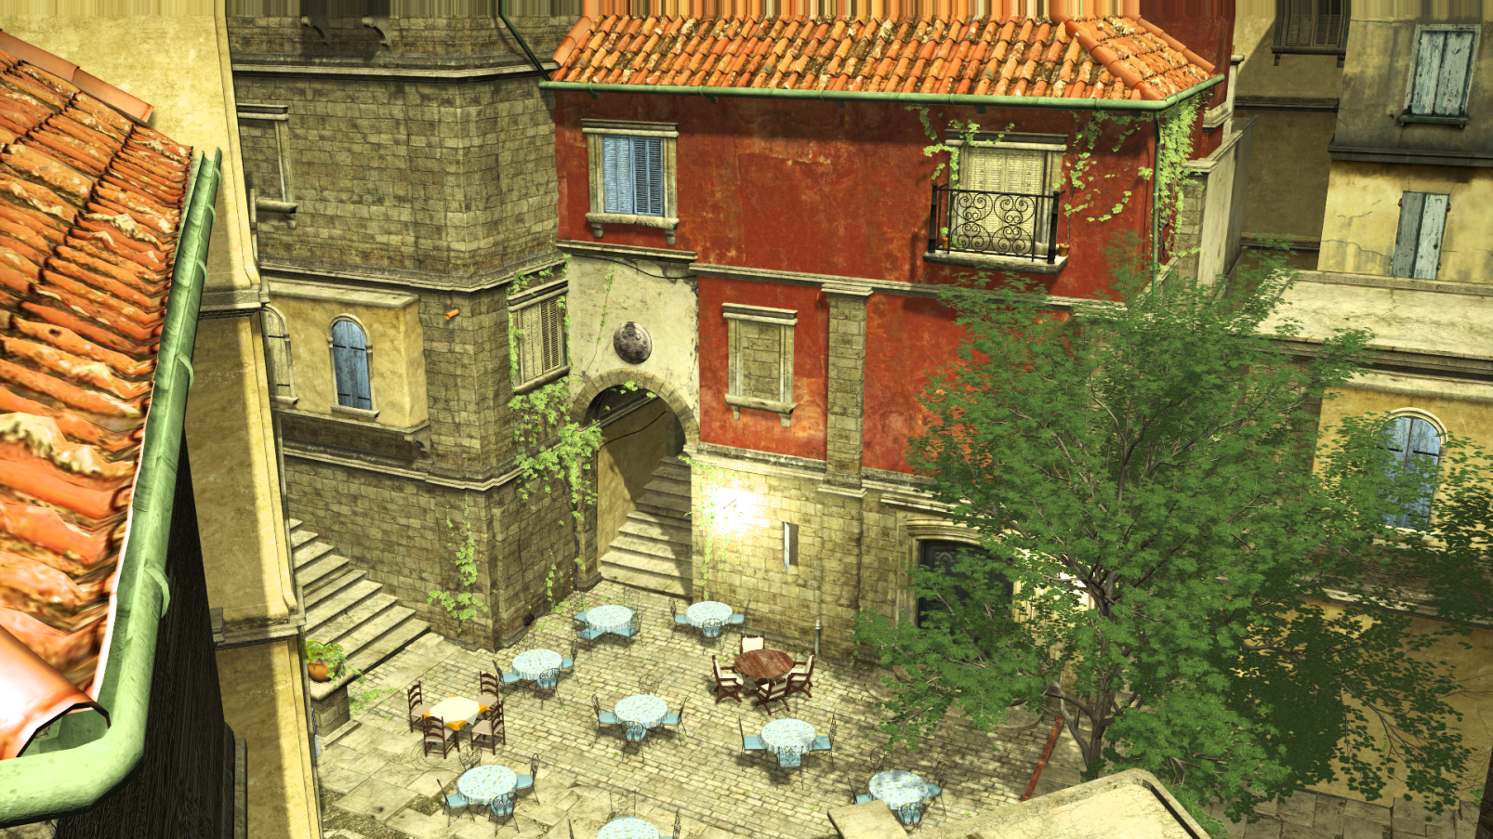
Aggregate g-buffer Anti-Aliasing
Cyril Crassin¹, Morgan McGuire^{1,2}, Kayvon Fatahalian³, Aaron Lefohn¹
¹NVIDIA ²Williams College ³Carnegie Mellon University
Notes:
Good morning. Thank you for the introduction.
First I would like to say that despite the name ag*AA*, I am not going to present a new Screen-space post-processing technique…

Slide 2
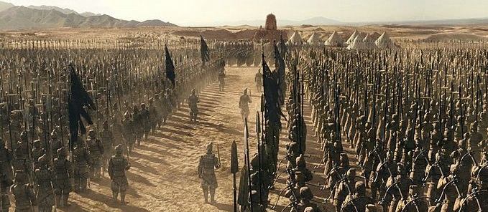
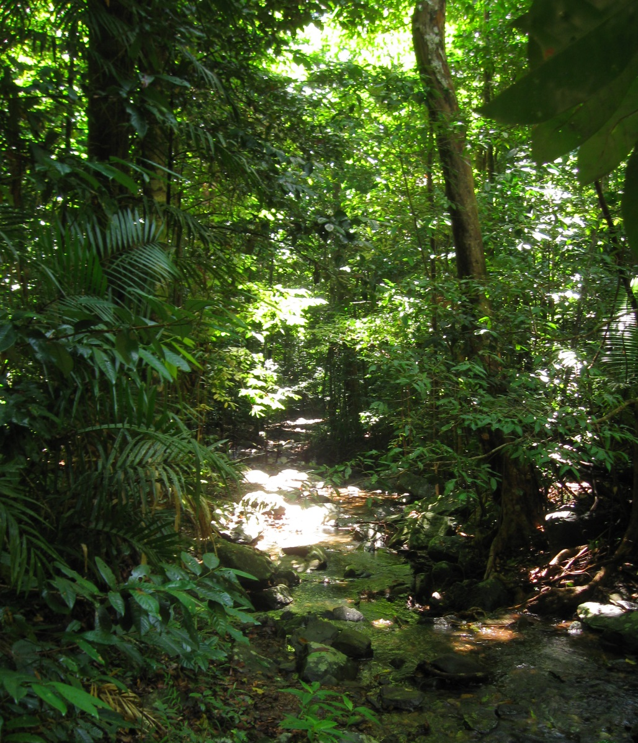
Motivation
Pixel
The Mummy – [© Universal Pictures / Digital Domain / Rhythm&Hues]
Notes:
Good anti-aliasing is crucial to bring film-like quality to real-time,
and *this* is the kind of scenes that we typically see as a challenge for real-time. And this is actually all cases, where post-processing antialiasing techniques fail….
#In such scenes, you have a *very* large number of sub-pixel details.
And they are actual *geometry*, that needs to be sampled at very high rates, in order to preserve appearance, and to avoid aliasing.

Slide 3
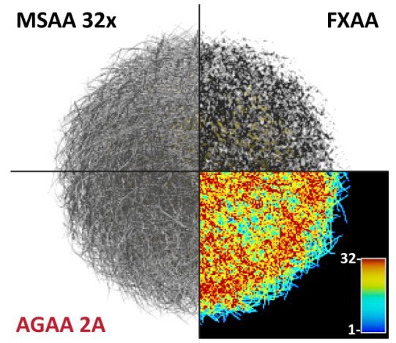
Overview
Pixel frustum
Pixel frustum
Pixel frustum
High frequency shading is too costly
Idea: Strong decoupling of shading rate
Shading statistical geometry distributions
Aggregate 1
Aggregate 0
Pixel
Aggregate shading
Per-sample visibility and shading attributes
Notes:
What we propose with AGAA , is a new GPU deferred shading technique #which *does* sample sub-pixel geometry at high frequency, like what MSAA would do,
but it actually *shades* at a much *lower* frequency, while preserving appearance.
The general idea here, is #*instead* of shading individual samples, to dynamically build and shade a few *statistical distributions* of sub-pixel geometry, that we call *aggregates*.
#On this furball for instance, we shade only two aggregates per-pixel, and we reach similar quality than 32x super-sampling.
Generally, we see this technique as a path forward for driving up geometric sampling rate, in real-time applications.

Slide 4
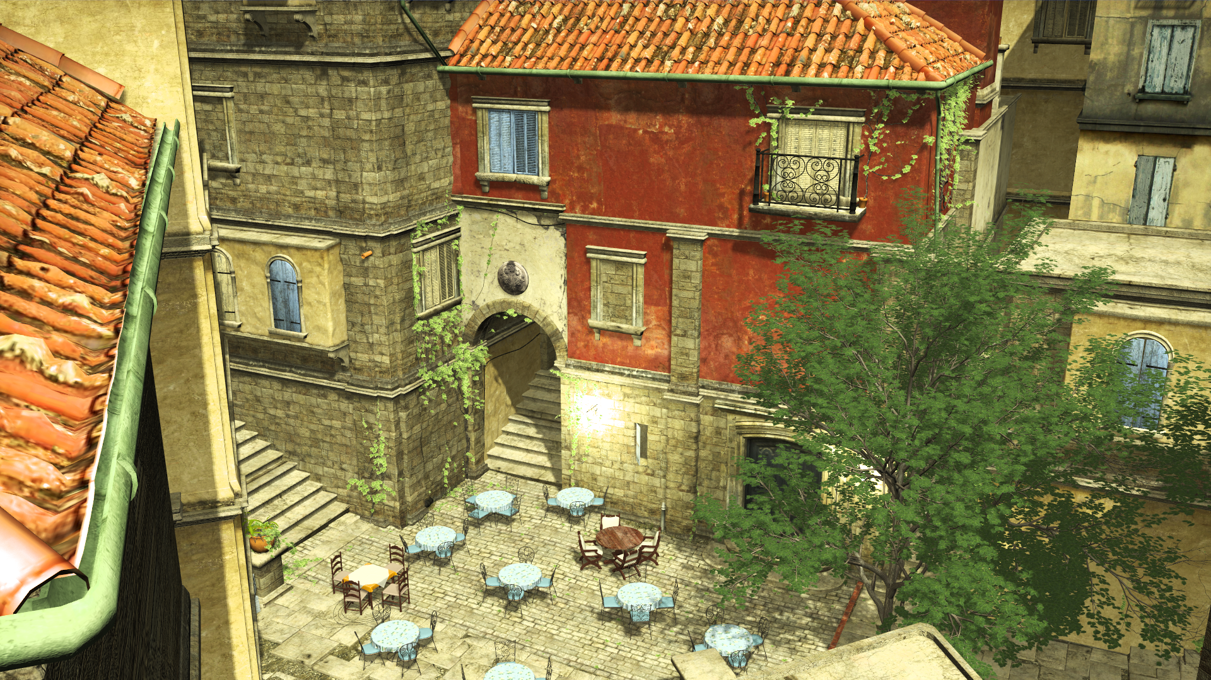
Notes:
So let’s take this scene as an example… it’ actually pretty complex…

Slide 5
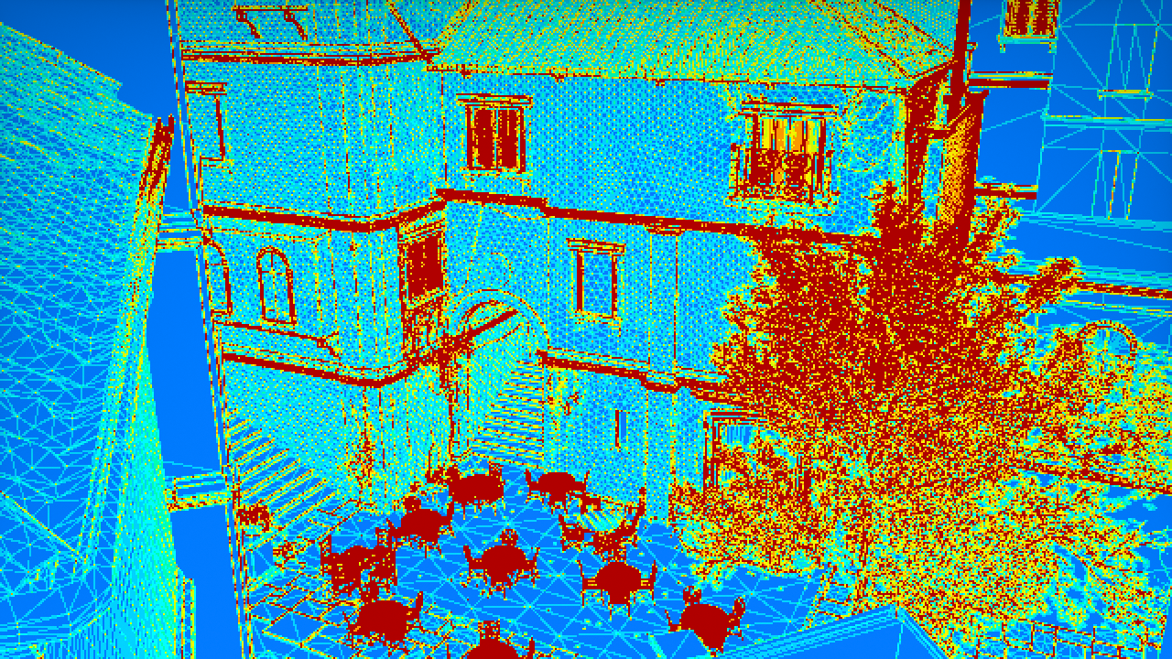
8
1
Notes:
... It contains fairly detailed geometry, with more than 10 triangles per-pixels in some of the red regions here…

Slide 6
Notes:
…and on this scene, we use 8x MSAA, and we achieve almost 80% of shading rate reduction, compared to a classical deferred shading technique.
In terms of execution performance, this results in almost 3x speedup for the shading pass alone,
and more than 50% speedup on the entire frame.

Slide 7
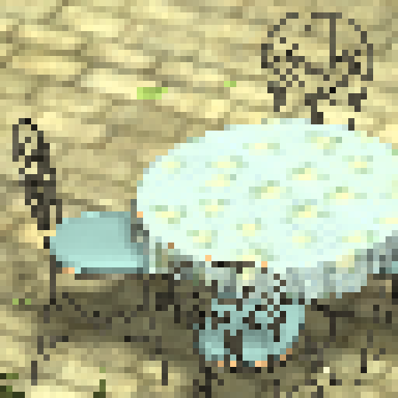
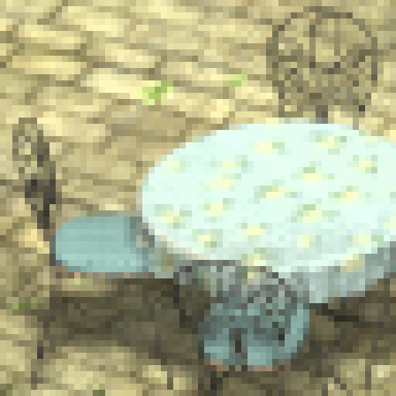
Single-sampled
MSAA 8x
AGAA (2A)
Notes:
And as you can see, here on the furniture, the quality is nearly identical to 8x MSAA, while we never shade more than twice per-pixel.

Slide 8
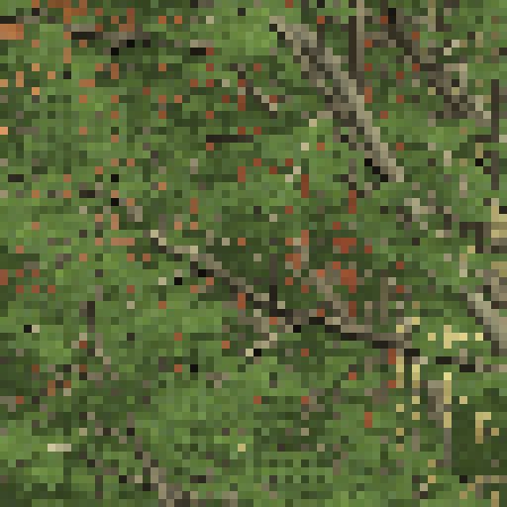
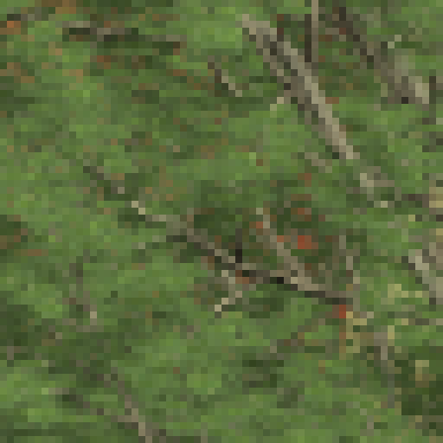
Single-sampled
MSAA 8x
AGAA (2A)
Notes:
It also works very well on the foliage, here. This actually use both geometry, and alpha to coverage transparency…

Slide 9
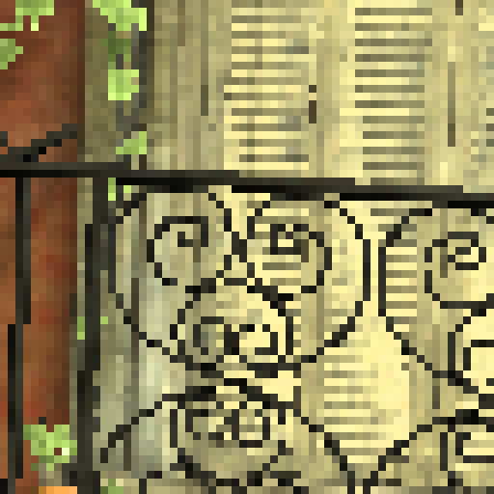
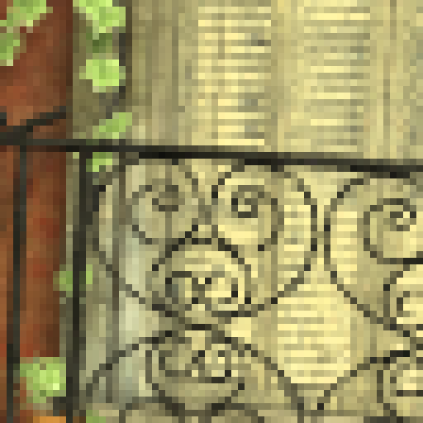
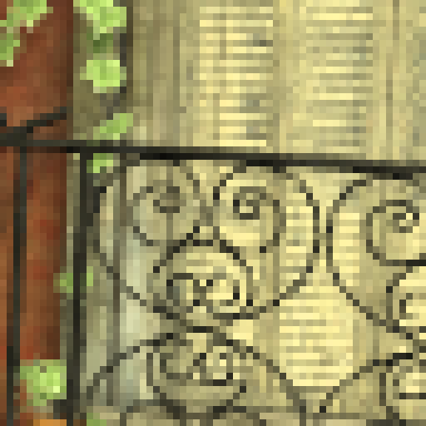
Single-sampled
MSAA 8x
AGAA (2A)
Notes:
The railings and shutters here are actually made of hundreds of tiny triangles.

Slide 10
Related work 1/2
Deferred shading
Simple/Complex [Lauritzen 2010]
Segmentation based on geometric complexity
Shading amortization:
Across same planar surface
…Or almost planar -> Quality reduction
Simple scenes + large memory requirement
Credit: Crytek [Sousa 2013]
Notes:
Decoupling visibility sampling from shading is not a new idea of course, that’s basically what’s forward MSAA does.
But MSAA can’t go below shading once *per-triangle* per-pixel.
Deferred shading potentially allows more shading rate reduction, and multiple techniques have been proposed to exploit that.
The “Simple/Complex” approach is… probably.. what most deferred renderers use if they rely on MSAA.
#As the name suggest, the idea is to detect the “simple” pixels -with only one planar surface- and to shade them once…
While the complex pixels are shaded per-sample. But it still generates a full super-sampled G-Buffer.
#It works for relatively simple scenes, but it doesn’t really help when most pixels end up with more then one surface.

Slide 11
Related work 2/2
Pixel frustum
Pixel frustum
Surface Based Anti-Aliasing (SBAA) [Salvi 2012]
High frequency visibility
Simplified geometry pre-pass
Only store and shade the n most contributing surfaces
Non-shaded surface information discarded -> Aliasing in complex regions
[Salvi 2012]
SBAA
SSAA
MSAA
SBAA
Notes:
Surface Based Anti-Aliasing, or SBAA, improves over the Simple/Complex approach.
#It evaluates visibility at high frequency, using a multi-sampled Z-buffer. But instead of storing shading attributes at this frequency,
#it selects only the n most contributing surfaces for each pixel, based on their coverage, and it stores and shades attributes only for those surfaces.
#The other surfaces are just *discarded*.
This allows bounding the storage *and* the shading computation,
but this is at the cost of a reduction in quality in the complex regions, where more than n surfaces are contributing.
So SBAA not really designed to provide high quality when “complexity” is everywhere on the screen.

Slide 12
AGAA overview
Pixel frustum
Pixel frustum
Integrate ALL geometry samples
All surfaces + curvature
Accumulate and filter geometry samples in pixel-space before shading
Per-sample visibility (Z-buffer)
Similar to texture/voxel-space pre-filtering
But pixel-space + on-the-fly aggregation
Aggregate G-Buffer statics:
Normal Distribution Function (NDF) + sub-pixel position distribution.
Average Albedo, Metal coef., emissive, etc.
Aggregate 1
Aggregate 0
Aggregate shading attributes
Per-sample visibility and shading attributes
Notes:
Like SBAA, AGAA also evaluates visibility per-sample at full rate.
But in contrast to SBAA, what *we* propose is *not* to discard *any* sample.
#Instead, we group them together dynamically into aggregates, and we *filter* their attributes, *before* shading.
We call the resulting data structure an “Aggregate G-Buffer”.
At the end, instead of shading individual samples, we shade each of these filtered aggregates, once.
#We actually take inspiration from texture maps pre-filtering techniques, as well as voxel-based filtering.
The main difference here is that we work in pixel-space, and we perform the prefiltering *dynamically*, during rendering.
#Each aggregate contains a statistical description of the surface, and shading attributes, that we filtered.
We have a normal distribution function, which models the orientations of the filtered primitives, as well as the microfacet distribution of their material.
We also keep a distribution of sub-pixel positions, which will be necessary for proper shadowing,
and we average the other shading attributes, like the albedo.

Slide 13
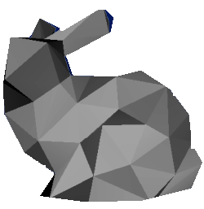
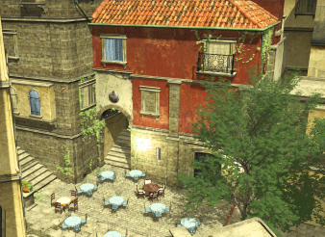
Rendering with Aggregates
Framebuffer 8xAA
Depth Prepass
Depth
Pixel
Raster pass
[8x Samples]
AG-Buffer
Early depth testing
2xAA
G-Buffer
8xAA
G-Buffer Generation
AG-Buffer Generation
NDF
Deferred Shading
Normal
Conversion
Mean albedo
Albedo
Blend
Mean metal
Metal
…
…
Raster pass
Pixel
Raster pass
Pixel
[8x Samples]
[2x Aggregates]
Notes:
Now, how do we effectively render with these aggregates ?
Like a traditional G-Buffer, the Aggregate G-Buffer illustrated here, stores its parameters as multi-sampled texture maps.
The difference is that each sample contain an aggregate value, instead of an individual geometry sample.
So here we use two aggregates, and so the texture maps store two samples.
#We use this AG-Buffer as input of the deferred shading step, to produce the final image.
#We could generate the AG-Buffer from a fully super-sampled G-Buffer…
But generating the supersampled G-Buffer, and doing this conversion, it would be quite expensive, both in terms of processing time, as well as memory storage, and bandwidth.
#So we avoid doing that.
#Instead, we directly rasterize the scene into the Aggregate G-Buffer, using high sampling rate…
… and we accumulate the shading parameters on-the-fly, into the filtered representation.
This is basically a weighted average of the fragments contributions, based on visibility, and we use hardware blending to do that.
For this to work, we need to make sure that the samples that we accumulate are visible.
#So we need to first perform *another* rasterization pass, which generates a depth buffer, and provides visibility at high sampling rate.

Slide 14
Rendering with Aggregates
Framebuffer 8xAA
Depth Prepass
Depth
Aggregate Definition
Face normal
Aggregate Meta Data
Pixel
[Per-pixel]
Raster pass
[8x Samples]
AG-Buffer
Early depth testing
2xAA
AG-Buffer Generation
NDF
Deferred Shading
Mean albedo
Blend
Mean metal
…
Raster pass
Pixel
[2x Aggregates]
Notes:
The AG-Buffer generation steps also need to chose into which of the two aggregates to accumulate the sample values.
#We build the sample-to-aggregate mapping with an “aggregate definition” step.
It clusters the samples based on their depth values, PLUS an additional low-precision normal information.
Now when you think about it, this AG-Buffer generation steps is quite original, because it rasterize the scene and performs depth-testing at high sampling rate,
but it blends values into a set of render targets which are sampled at a much lower frequency.
This actually requires a set of specific new hardware features which are exposed by our Maxwell architecture.

Slide 15
Aggregate definition
Framebuffer 8xAA
Depth
Aggregate Definition
Face normal
Aggregate Meta Data
Pixel
[Per-pixel]
Clustering visibility samples:
Cross-primitives + Disjoint surfaces
Goal: Minimize shading errors due to correlated attributes [Bruneton and Neyret 2012]
Distance function:
Orientation + distance-based clustering
Control over characteristic length of the scene
[8x Samples]
Pixel frustum
Pixel frustum
Aggregate 0
Aggregate 1
Light source
Notes:
Now let’s take a closer look into the aggregate definition step.
The goal here is to assign each visibility sample, to one of the aggregates. And we use a clustering scheme to do that.
Unlike previous techniques, like SBAA, we support aggregating samples from primitives with different orientations, and also disjoint surfaces.
#What we want here is basically to minimize the shading errors.
By independently pre-filtering the inputs of the shading function, the main assumption that we do is that the values taken by these parameters, are statistically independent.
Of course in practice, there is *always* some degrees of correlation, especially because we don’t necessarily have a lot samples.
Most issues come from a correlation with either #the surface orientations, which determines shading, or #the shadowing term.
Since shadowing information is not available when we cluster, we assume that shadowing discontinuities are low frequency, and #we use the spatial proximity to approximate shadowing similarity.
#So, our clustering scheme favors both distance-based and orientation-based grouping of samples, and we provide a control over the relative importance of the two criteria.

Slide 16
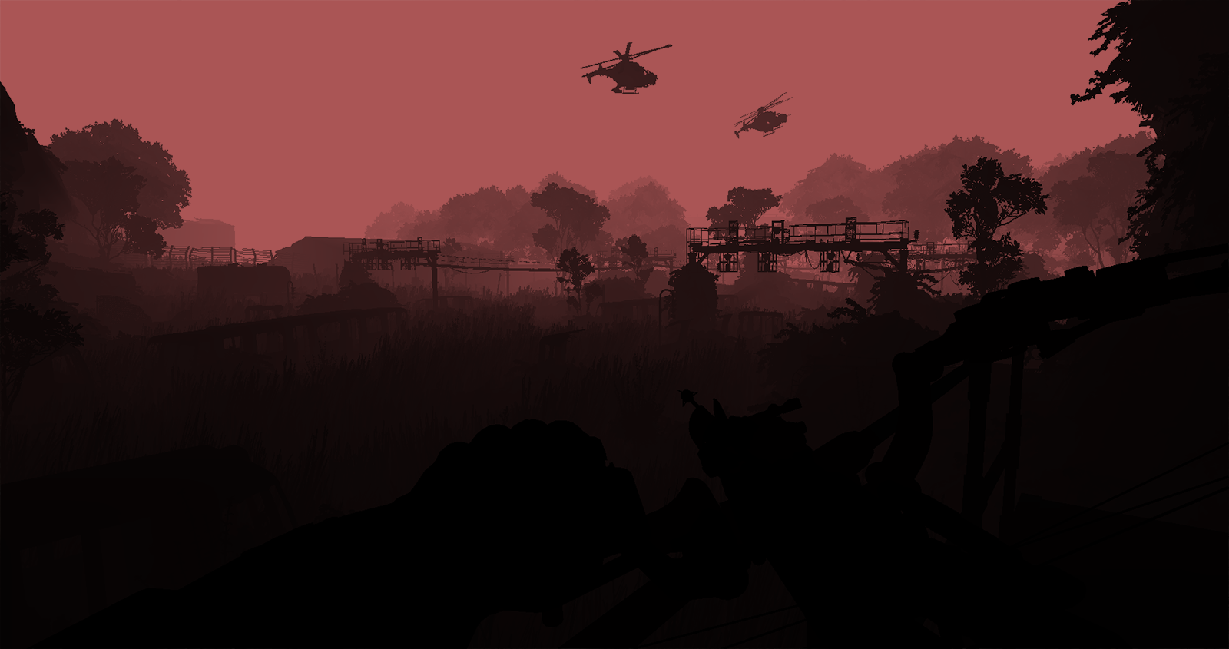
Deferred Shading
Depth buffer
AG-Buffer
2xAA
Deferred Shading
NDF
Mean albedo
Mean metal
…
Similar to shading from filtered texture maps
AGAA is independent from the shading model
We used the Blinn-Phong BRDF model
Filtering Specular component using Toksvig [Toksvig 2005]
+Analytic approx. from Toksvig for Lambertian diffuse [Baker and Hill 2012]
Shadowing must be filtered
Pixel
[2x Aggregates]
Pixel frustum
Aggregate 1
Shadow map
Aggregate 0
Notes:
Finally, how do we *shade* the aggregates ?
This is actually very close to shading from MIP-mapped texture samples, using filtered normal-mapped details.
We chose to use the Blinn-Phong BRDF model for our experiments. But generally, the technique is independent from the shading model, and in theory other analytic microfacets distributions could be used, as long as it exists pre-filtering schemes, and that their parameters are linearly filterable.
We encode the Normal distribution using Toksvig’s approach, which is basically approximating the variance in the normal directions from the length of a 3D normal vector.
In contrast to filtering micro-scale texture details, we filter not only the specular component,
but *also* the diffuse component, because it has an important impact on the final image quality.
Finally, #because our aggregates can spread large depth extents, we also need to filter the shadowing, to account for differences of light visibility inside an aggregate.

Slide 17
Notes:
Now, let’s take a look at some more image quality results...
[16 light sources]

Slide 18
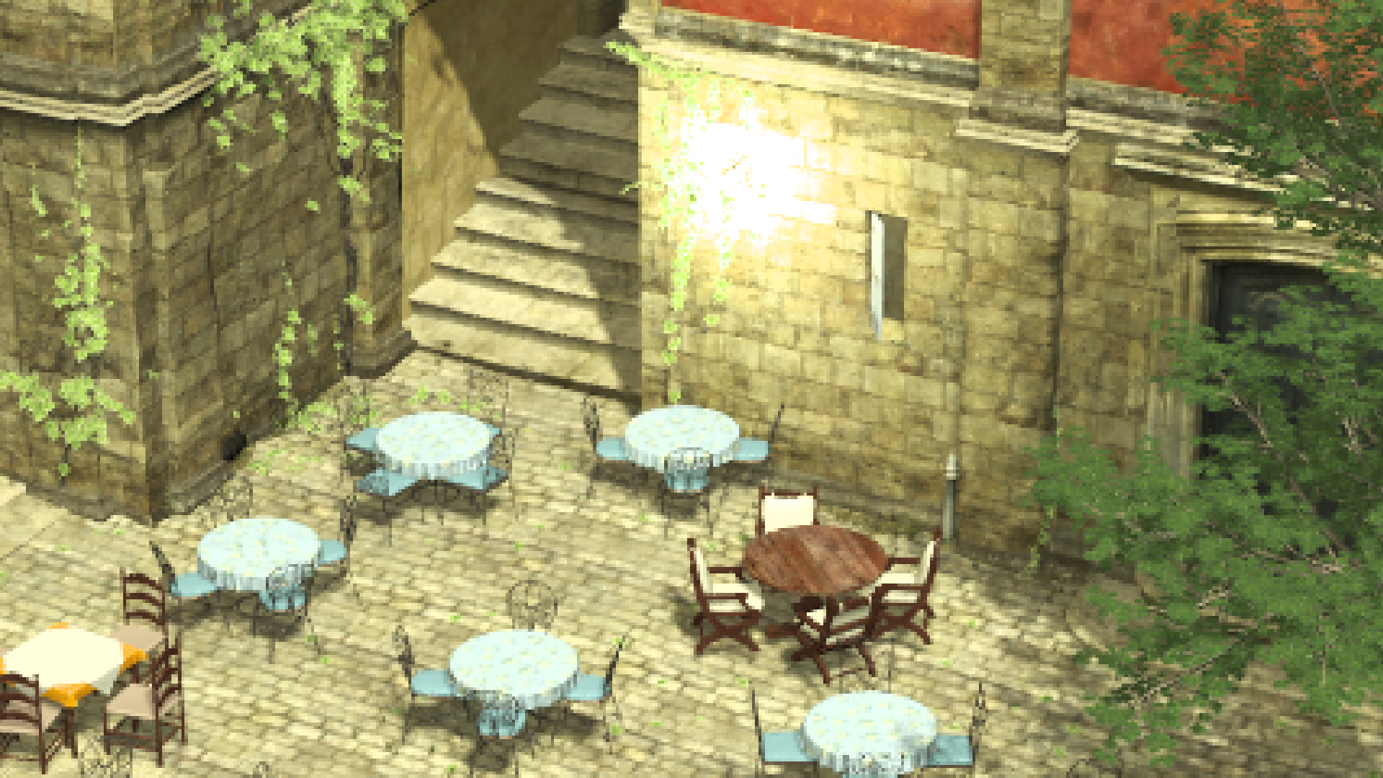
Deferred 8x (reference)
Notes:
This is our reference quality picture, which does per-sample shading on an 8x multi-sampled G-Buffer.

Slide 19
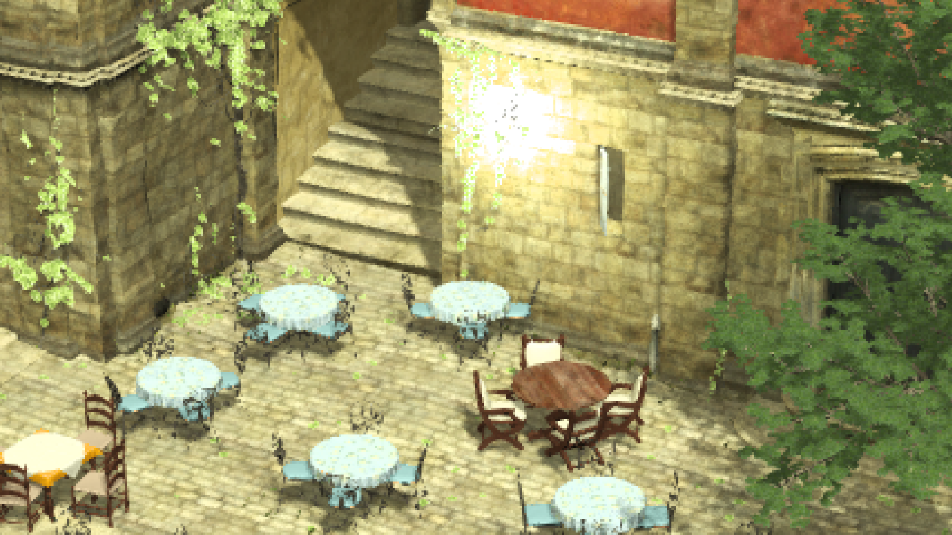
FXAA
Notes:
As we have seen before, this scene contains important sub-pixel details …And post-processing techniques, like FXAA, totally fail.

Slide 20
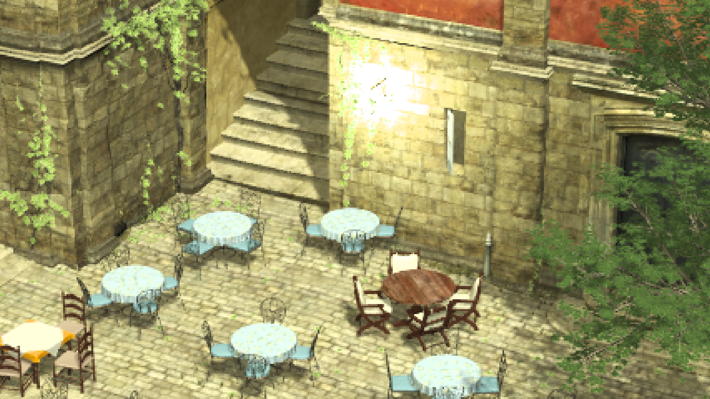
AGAA (1A)
Memory: 41 MB
Shading events: 1 /Pixel
Notes:
In comparison, here is what we achieve with AGAA, if we use only one aggregate per-pixel…
It’s actually not so bad for shading only once, but there is some annoying visible artefacts…
#like the halos on the foliage here, which are due to correlation issues with the shadowing.

Slide 21
AGAA (2A)
Memory: 71 MB
Shading events: 1.51 /Pixel
Notes:
… Now if we go up to *two* aggregates per-pixel..
then we get very similar result than 8x super-sampled shading…

Slide 22
Deferred 8x (reference)
Memory: 112 MB
Shading events: 6.68 /Pixel (Simple/Complex)
Notes:
… This is 8x supersampled ….

Slide 23
AGAA (2A)
Memory: 71 MB
Shading events: 1.51 /Pixel
Notes:
And we do only 1.5 shading executions per pixel, on average.
Which is less than ¼ th of the average shading rate of the Simple/Complex approach for instance.
#Note that the metallic parts here exhibit specular shading, that does get filtered correctly by our model. You can find more specular shading results in the paper.

Slide 24
SBAA (2S)
Memory: 88 MB
Shading events: 1.72 /Pixel
Notes:
Now if we compare to SBAA, using two surfaces per-pixel, we see that it fails to preserve the appearance of the sub-pixel details.

Slide 25
SBAA (6S)
Memory: 137 MB
Shading events: 3.32 /Pixel
Notes:
We need to go up to 6 surfaces per-pixel with SBAA to reach a quality close to the supersampled reference,
And, on average, it requires twice as much shading executions as AGAA… and twice the memory.

Slide 26
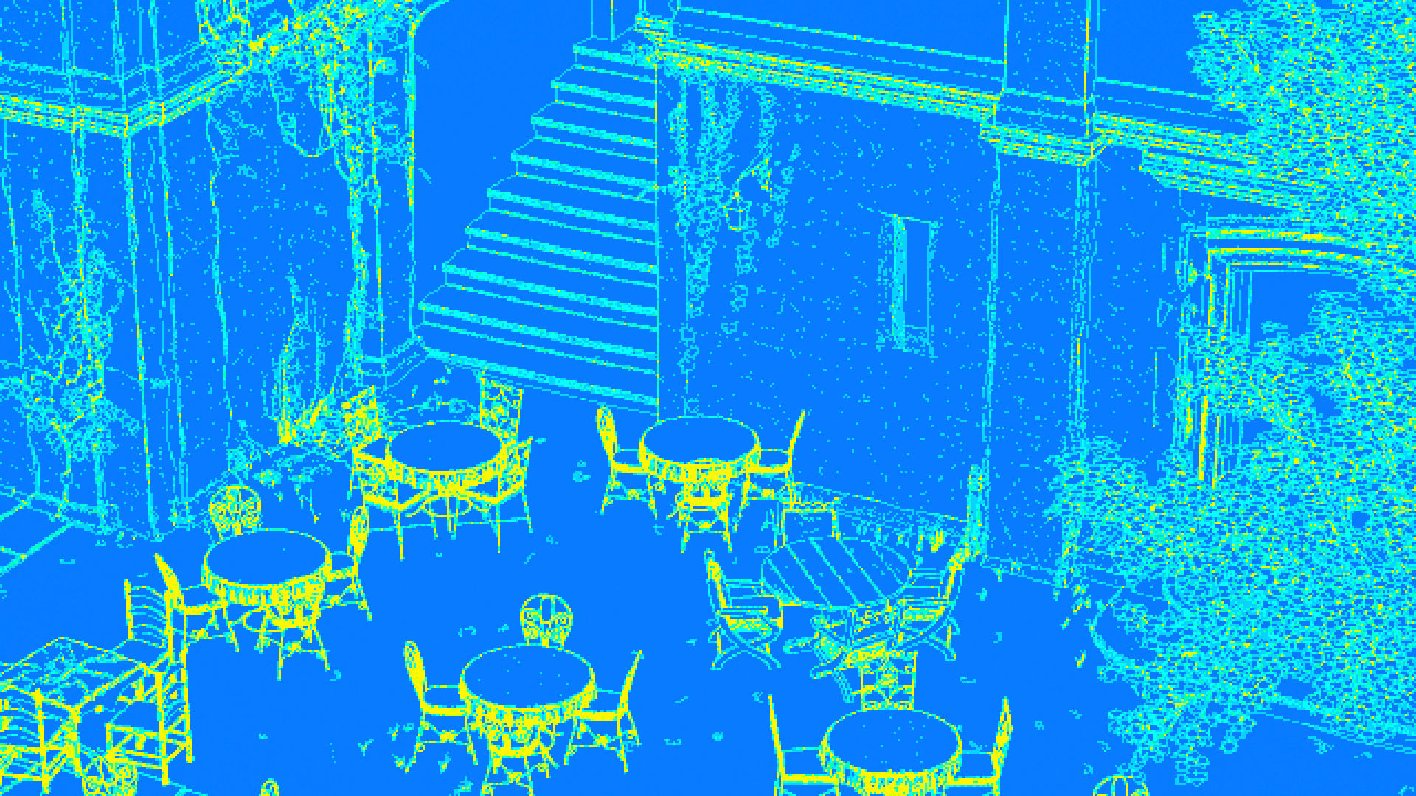
SBAA (6S)
8
1
Memory: 137 MB
Shading events: 1.72 /Pixel
Notes:
Actually, it turns out that shading with SBAA is quite inefficient on the GPU...
This represents the logical number of shading executions per-pixel.

Slide 27
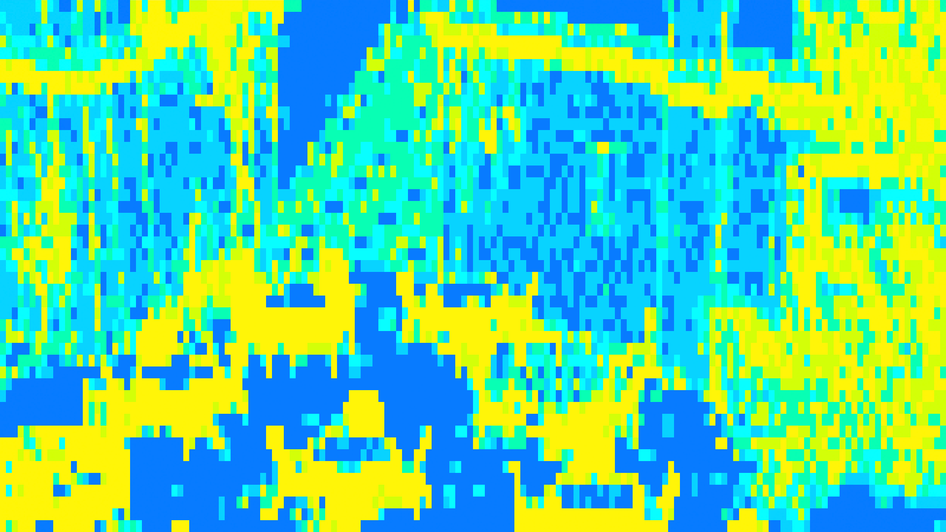
SBAA (6S)
8
1
Memory: 137 MB
Shading events: 3.32 /Pixel
Notes:
And due to the SIM-D scheduling of work, this is what the GPU actually happens to execute…
So the important pixel-to-pixel variation of the shading rate is actually very bad for SIM-D execution...

Slide 28
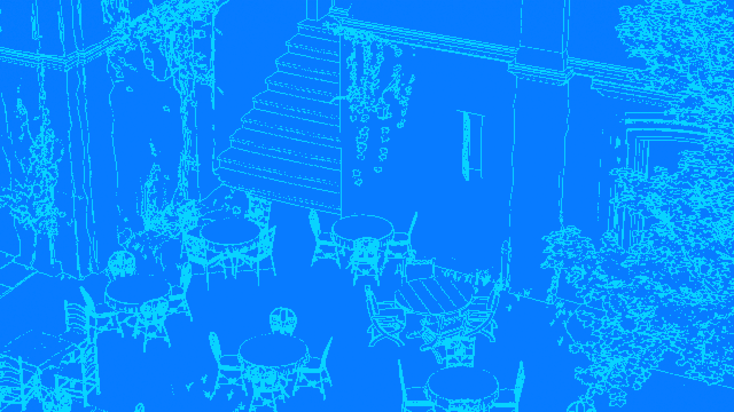
AGAA (2A)
8
1
Memory: 71 MB
Shading events: 1.51 /Pixel
Notes:
… And AGAA actually offers a much better execution coherence,
because it shades much less in the worst case.

Slide 29
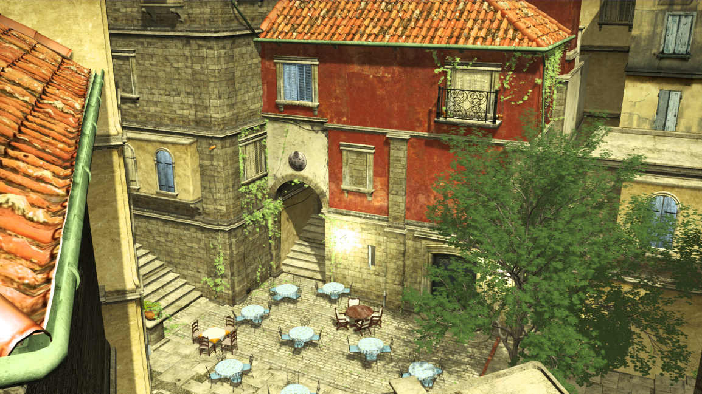
Results : Performance
Deferred shading @8x MSAA 720p - Comparison with Simple/Complex [Lauritzen 2010] - NVIDIA GTX980 (Maxwell GM204)
54% Faster rendering than Simple/Complex
(2.84x Faster shading)
Old City
Time (ms) | AGAA |  |  |  |  |  | Deferred Simple/Complex [Ref]
Scene | 1. Prepass | 2. Aggregate Def. | 3. AG-Buffer Generation | 4. Shading | Total |  | G-Buffer Gen. | Simple/ Complex | Shading | Total
OldCity | 2.61 | 0.6 | 3.8 | 3.6 | 10.61 |  | 5.73 | 0.41 | 10.24 | 16.38
UE3 FoliageMap | 2 | 0.6 | 2.47 | 3.67 | 8.74 |  | 4.35 | 0.41 | 10.45 | 15.21
Notes:
Now in terms of run-time performance, here is the results we got on a GTX 980 at 720p.
We use 8x MSAA since this is the highest that the GPU natively supports.
These results are actually better than the ones we report in the paper, because I was able to do various implementation optimizations since then.
We compare AGAA two Aggregates, with Simple/Complex.
On Old City, we get 54% speed-up on the entire frame, and up to 2.8 times faster shading pass.
The per-step timings are interesting, because we see that #eventhough we need to perform two geometry passes,
#their combined cost only slightly exceed the unique one of the simple/complex approach. This is mainly thanks to the bandwidth reduction of AGAA, as well as the efficiency of early-Z for culling work during the G-buffer generation.
#Similarly on the Unreal Engine 3 Foliage Map scene, our technique is 74% faster overall, and speeds up shading by almost 3x.

Slide 30
Results: Memory savings
AGAA G-Buffer layout: [16B/Aggregate + 6B/Sample]
% Memory relative to super-sampled G-Buffer
37% saving @8x - 2 Aggregates
20% less than SBAA @2 Surfaces - ~40% less @Iso quality
G-Buffer layout: [16B/sample]
Notes:
This graph shows the percentage of memory used by AGAA, relative to a super-sampled G-Buffer, for 1 to 4 aggregates. The 3 curves show 8x, 16x and 32x MSAA.
At 8x MSAA for instance
Even if, at 8x MSAA for instance, we only store ¼ of the shading attributes when using two aggregates, the memory reduction is limited to 37%.
This is due to the slightly larger precision required by the AG-buffer for the accumulation,
And also the fact the we still need to allocate a fully super-sampled depth buffer, as well as a low precision normal buffer, which represents almost 30% of the total memory.
Naturally, the relative saving increases with the MSAA rate.

Slide 31
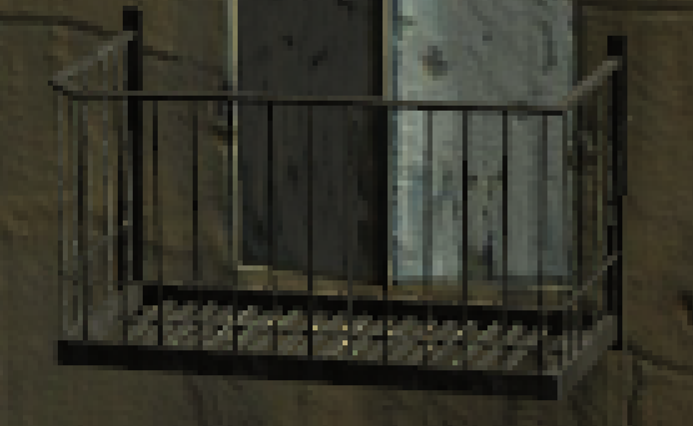
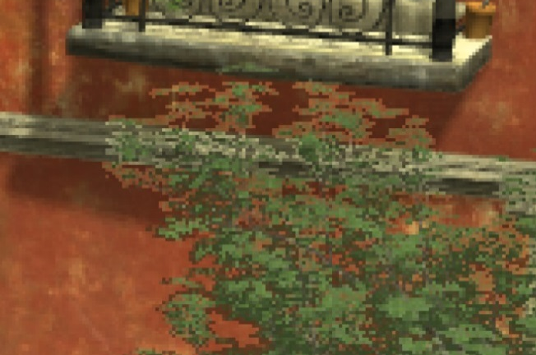
Constraints and Limitations
Unified material with unique shading model
No material switch (Skin, water, hair, cloth…)
All shading inputs must be filterable !
NDF precision:
A few very differently oriented surfaces
But uni-modal Gaussian distrib.
Specular sparkling
Correlation issues:
Lit green foliage + Shadowed red wall
1 Aggregate/ pixel
Notes:
Jut a few words about the constraints and limitations of the technique, before I conclude.
The most important constraint might be that we require a unified material representation and shading model.
This prohibits per-material switches for instance. This is often used for shading very different materials like skins, hairs or cloth.
It also requires that a pre-filtering scheme exists for the shading model, and that all the parameters are linearly filterable.
# Another limitation is he precision of the Normal Distribution function. It can create sparking in case of a few differently oriented surfaces, if not enough aggregates are used.
Here on the railings we only use one aggregate.
# Finally correlation issues….
[Very visible when using only 1 aggregate]

Slide 32
Conclusion
Path forward for very high sampling rates in real-time
Scalable: Bounded storage and shading rate
Properties:
Cross-primitives + Cross-surfaces amortization
All geometric details integrated
Remaining work on pre-filtering schemes for advanced unified shading/material models
Notes:
Now it’s time to conclude.
So our technique offers a path forward for driving up the sampling rate in real-time applications.
#It allows cross-surfaces shading amortization, while preserving the appearance of sub-pixel details.
# But as we jut seen, there is still issues to be worked out to be generally usable in game engines,
especialy regarding the pre-filtering of unified materials and shading models.

Slide 33
Thank you !
Questions ?
Notes:
And, I thank you for your attention !

Slide 35
Backups

Slide 36
Step 3: AG-Buffer generation
* [Maxwell or DX12 hardware specific features]
Rasterize @ sample frequency (Eg. 8x MSAA)
Inside a set of color buffers @ Aggregate frequency (Eg. 2x) *[TIR M->N]
Per-sample early depth testing
Fragment shader:
Generates attributes for accum., weighted by visible coverage *[Post-depth coverage]
Route output attributes into one of the aggregates *[Out coverage override]
Additive blending:
Additive blending inside AG-Buffer (weighted sum)
Depth buffer
Aggregate Meta Data
8x MSAA
Raster
Depth Test
Fragment Shader
Blend
(ADDITIVE)
AG-Buffer 2xAA
NDF
Mean albedo
Prim. Coverage
*Post-depth coverage
*Output coverage
(routing)
Mean metal
…
Fragment output attributes
Depth
Notes:
Now, that we know how to associate rasterized samples to destination aggregates, let’s take a look at how we generate the aggregate values themselves.
This rendering step is actually quite original, because it requires some specific hardware features which are currently only available on our Maxwell architecture. We prototypes this pipeline using OpenGL 4.5 and NVIDIA-specific extensions.
#So, we rasterize the scene using 8x MSAA,
#while binding the Aggregate G-Buffer color render targets, which are sampled at *aggregate* frequency. Here we use two aggregates, and consequently two samples per-pixel.
#For each triangle, the rasterizer generates a coverage mask, as well as depth values for each of the covered samples.
#The pipeline is configured in early depth testing mode, using the depth buffer generated in the first rasterization pass.
#This allows providing the fragment shader with an input coverage mask, which only contains the visible samples for the fragment, those passing the depth test.
#The fragment shader generates all the shading attributes in the right representation for filtering.
In order to correctly account for visibility, the post-depth test coverage mask is used to weight those attributes by the number of visible samples, which represent the actual contribution of the fragment to the pixel.
# Then, the fragment shader needs route these shading attributes into one of the two output aggregates for accumulation.
The selection of the aggregate is done dynamically for each fragment, using the aggregate meta data information generated in the previous step.
The actual routing of the output attributes is done by setting the corresponding sample in the output coverage mask. This coverage mask will be used by ROP to select which color buffer to accumulate into.
So in this case, there is no link between the primitive coverage represented in the input coverage mask, and the output coverage mask which is only used for routing purpose.
#After the fragment shader execution, the output attributes are additively blended into the AG-Buffer, using fixed-function ROPs blending.
At the end of this pass…. [TODO]

