Slide 1
Octree-Based Sparse Voxelization for Real-Time Global Illumination
Cyril Crassin
NVIDIA Research

Slide 2
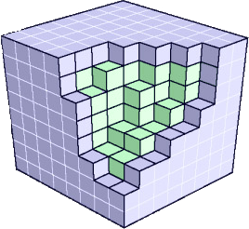
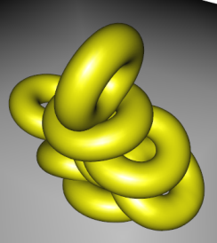
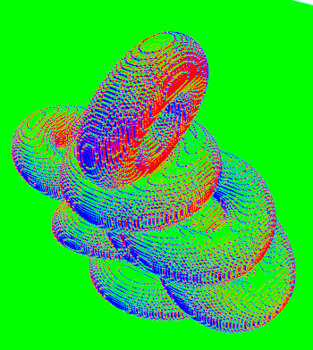
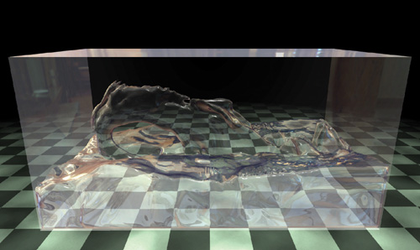
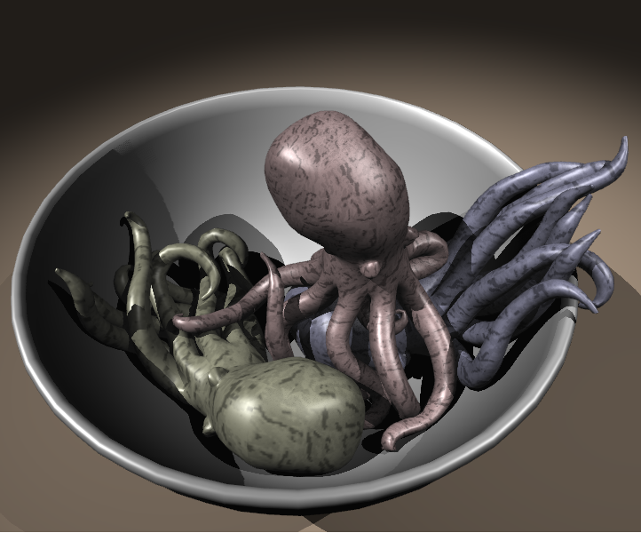
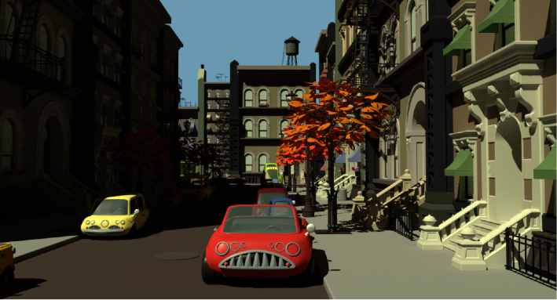
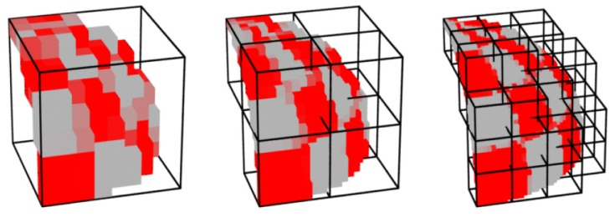
Voxel representations
Crane et al. (NVIDIA) 2007
Allard et al. 2010
Christensen and Batali (Pixar) 2004

Slide 3
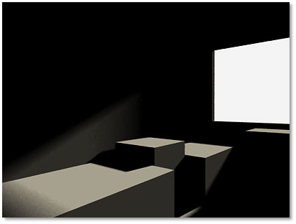
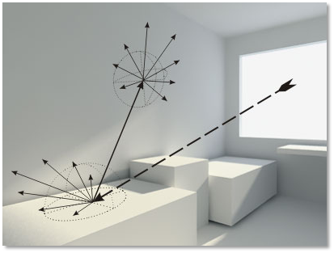
Global Illumination
Indirect effects
Important for realistic image synthesis
Direct lighting
Direct+Indirect lighting

Slide 4
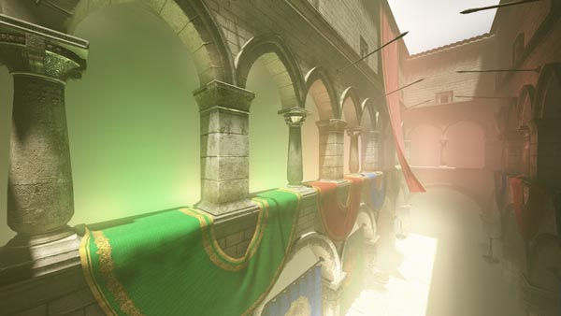
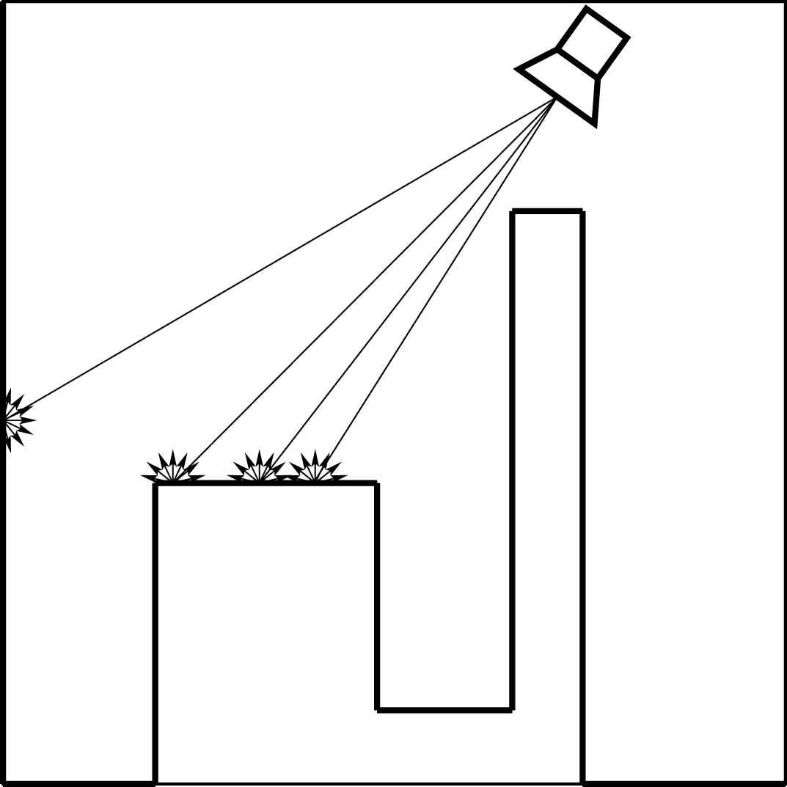
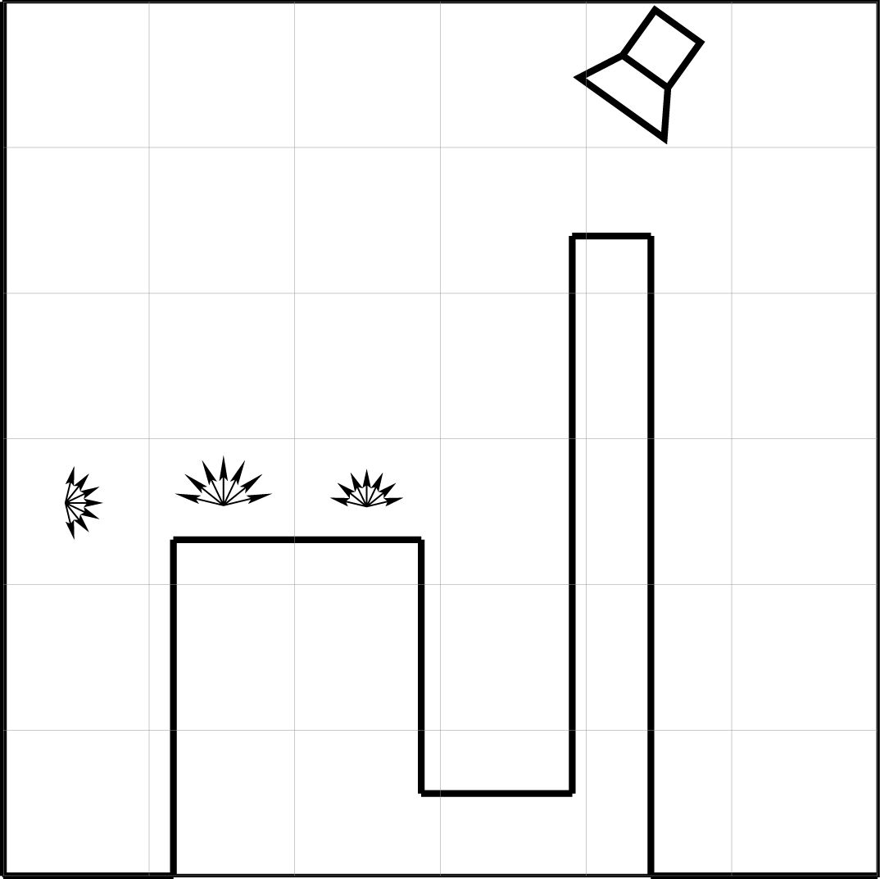
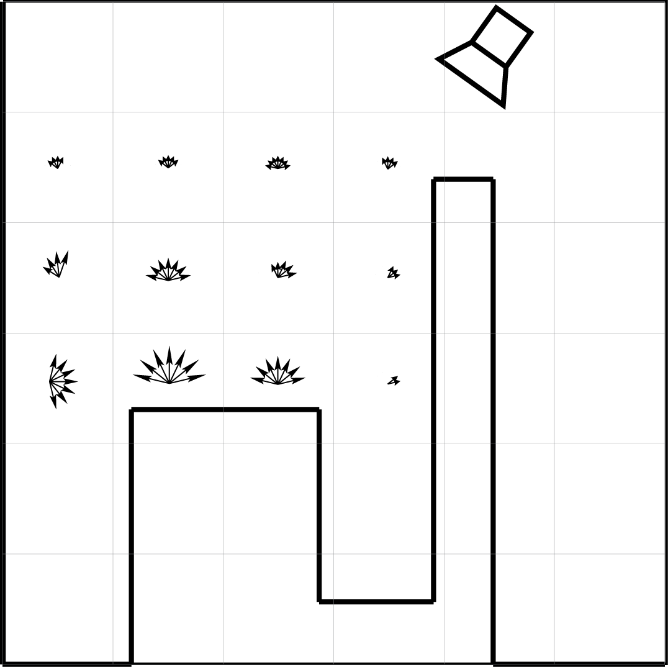
Light Propagation Volumes
[Kaplanyan & Dachsbacher 2010]
Limited resolution + Mostly diffuse
VPL
VPL
VPL
Reflective shadow maps
Radiance volume gathering
Iterative propagation

Slide 5
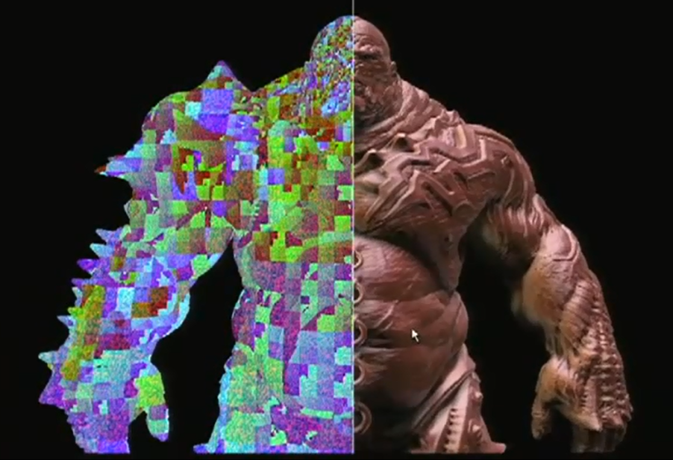
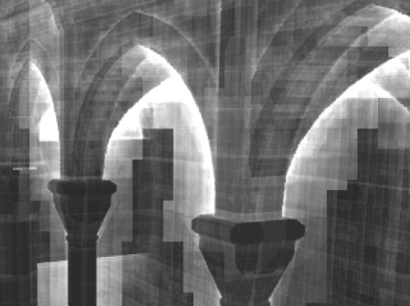
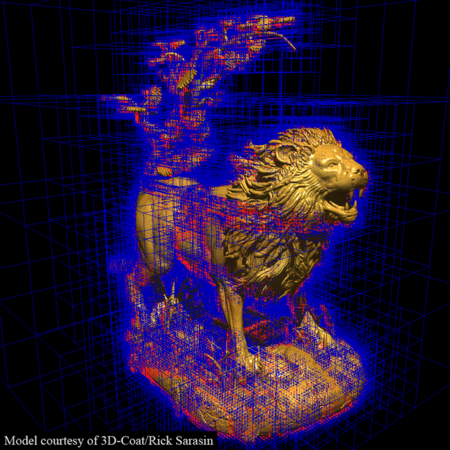
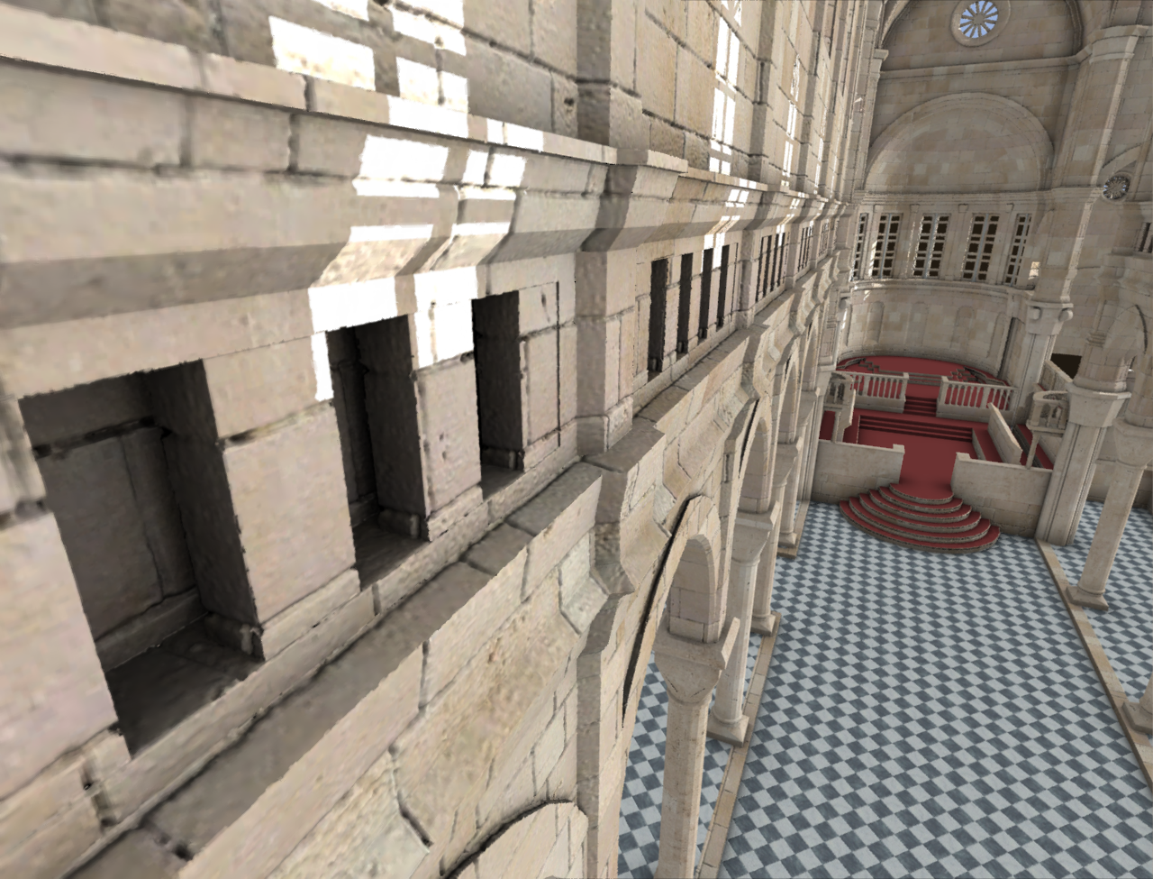
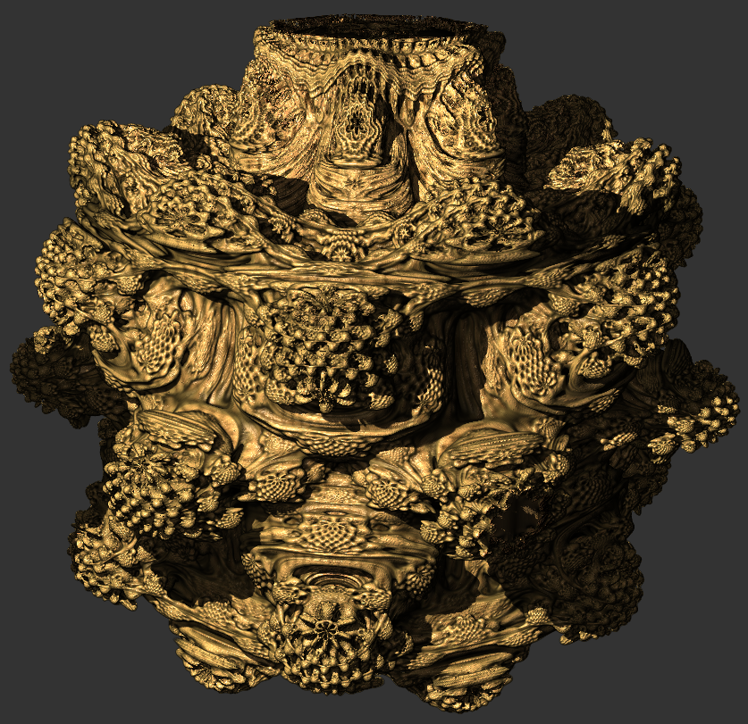
Sparse Voxel Octree
Detailed geometry rendering
Structured LODs
Olick. 2008
Laine and Karras (NVIDIA) 2010
Crassin et al. 2009 (GigaVoxels)

Slide 6
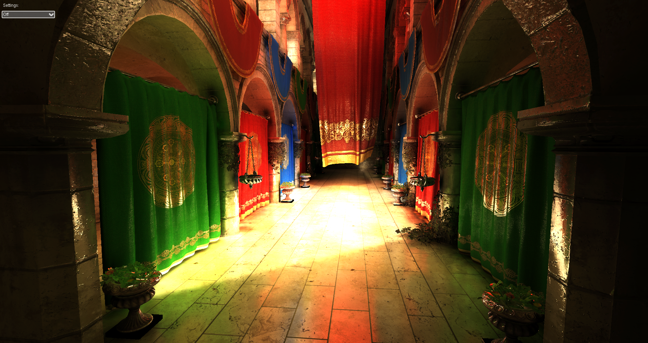
Interactive indirect illumination using voxel cone tracing
120 FPS @ 512x512 -- 16 FPS @ FullHD

Slide 7
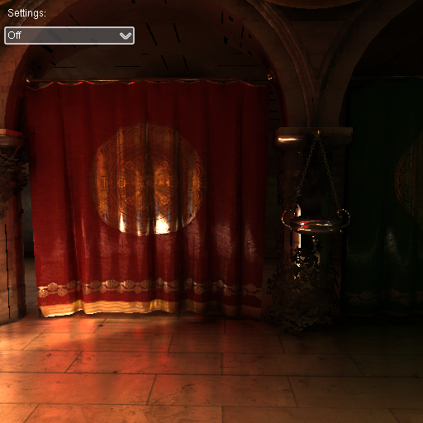
Publications
Interactive indirect illumination using voxel cone tracing
C. Crassin, F. Neyret, M. Sainz, S. Green, E. Eisemann
Computer Graphics Forum (Proc. of Pacific Graphics 2011)
http://research.nvidia.com/publication/interactive-indirect-illumination-using-voxel-cone-tracing
I3D 2011 Poster
http://maverick.inria.fr/Publications/2011/CNSGE11/
Siggraph 2011 Talk
http://maverick.inria.fr/Publications/2011/CNSGE11a/

Slide 8
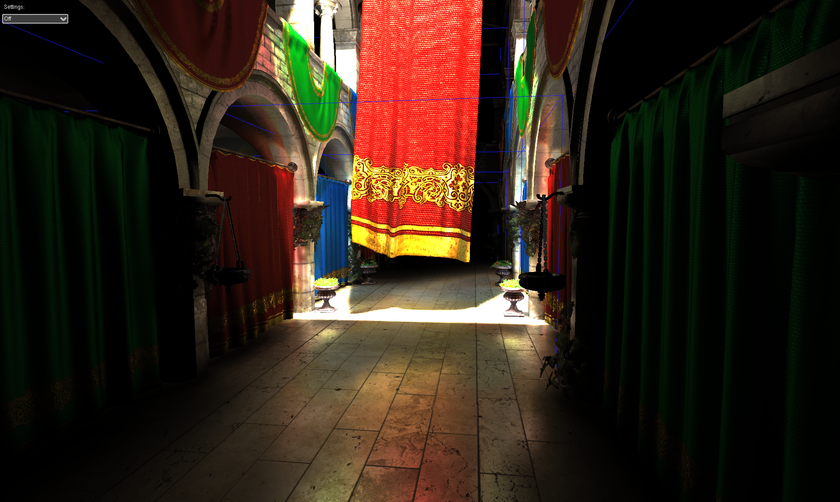
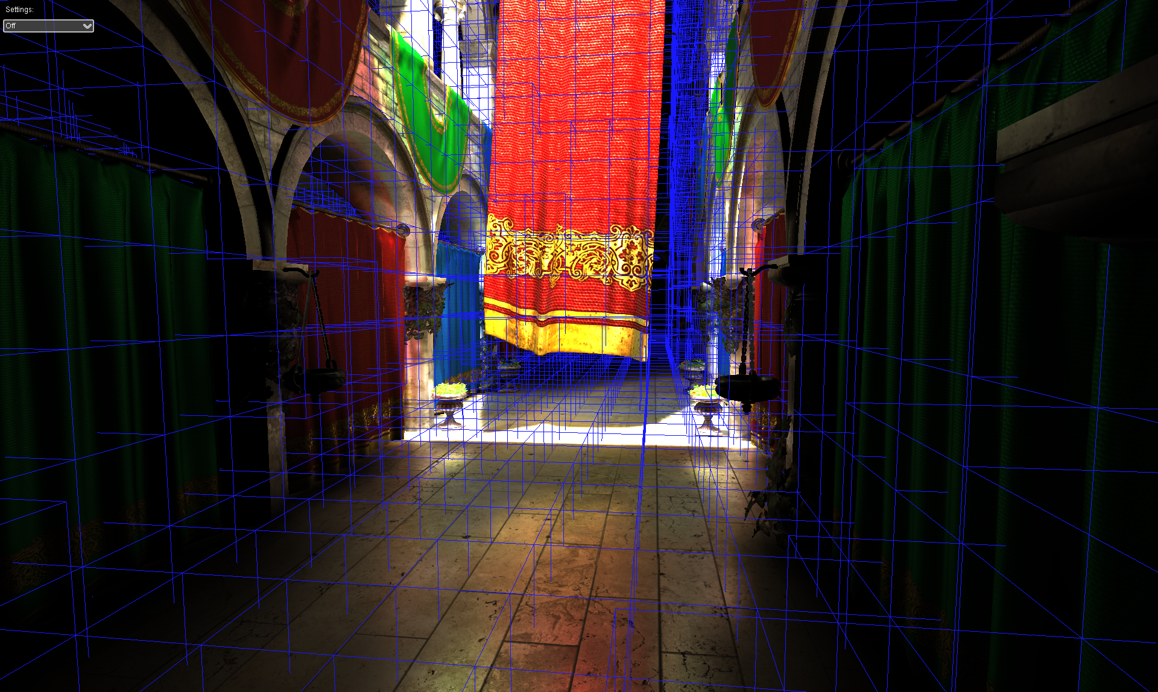
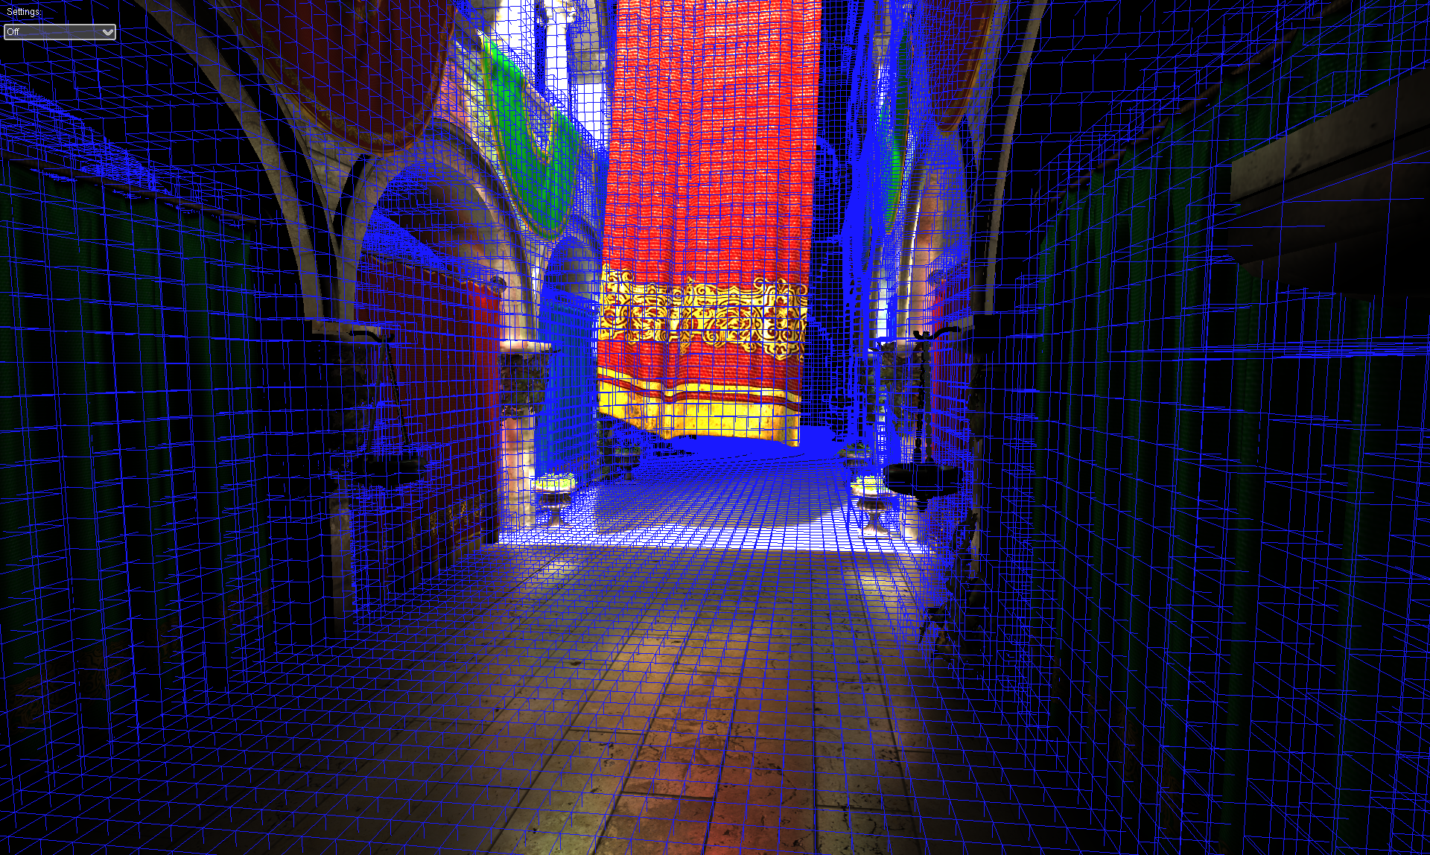
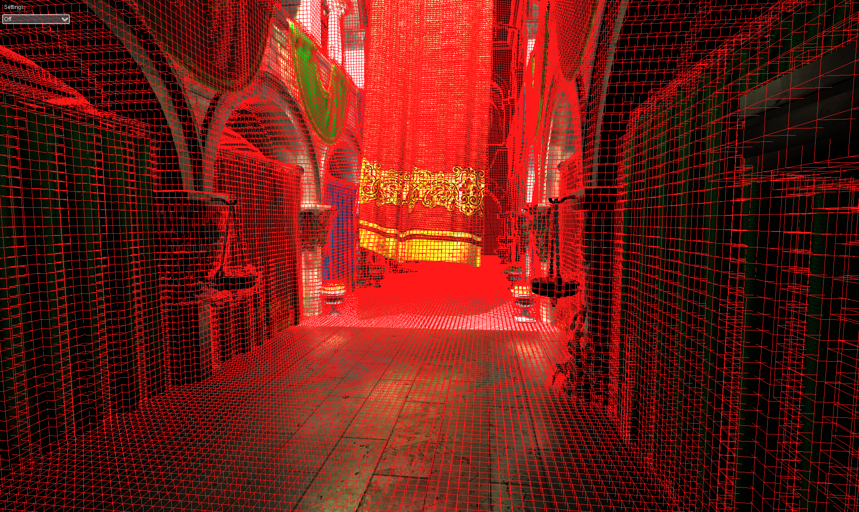

Slide 9
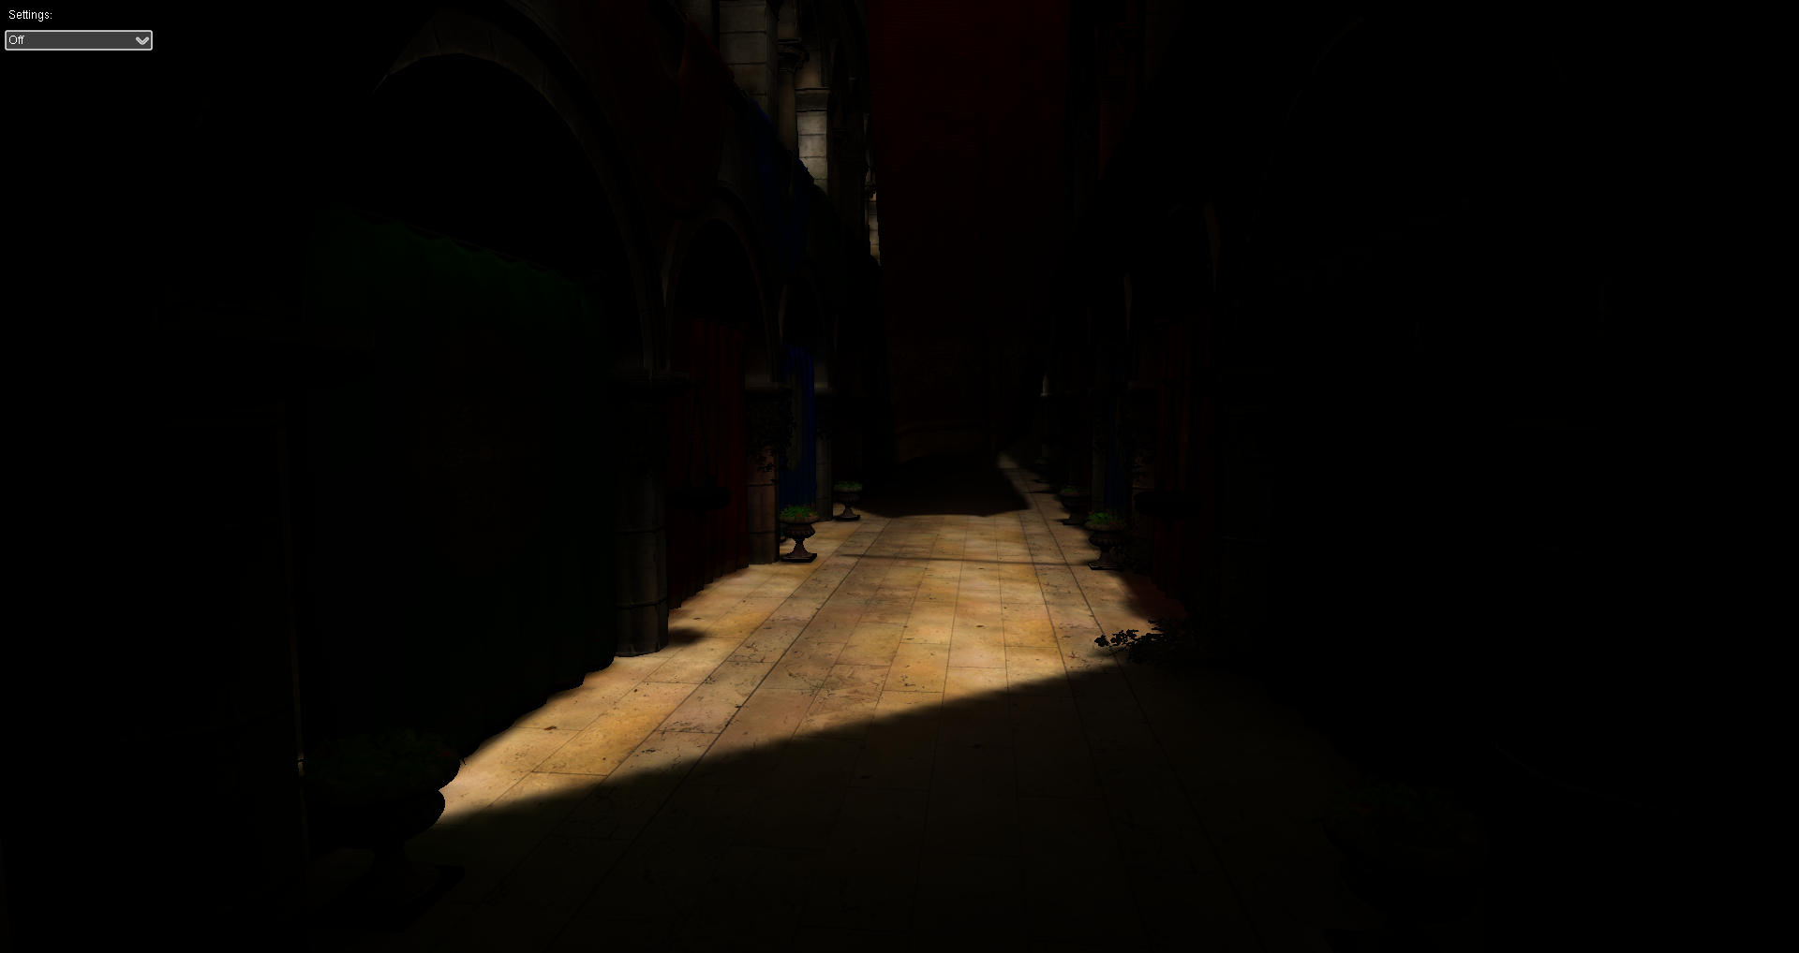
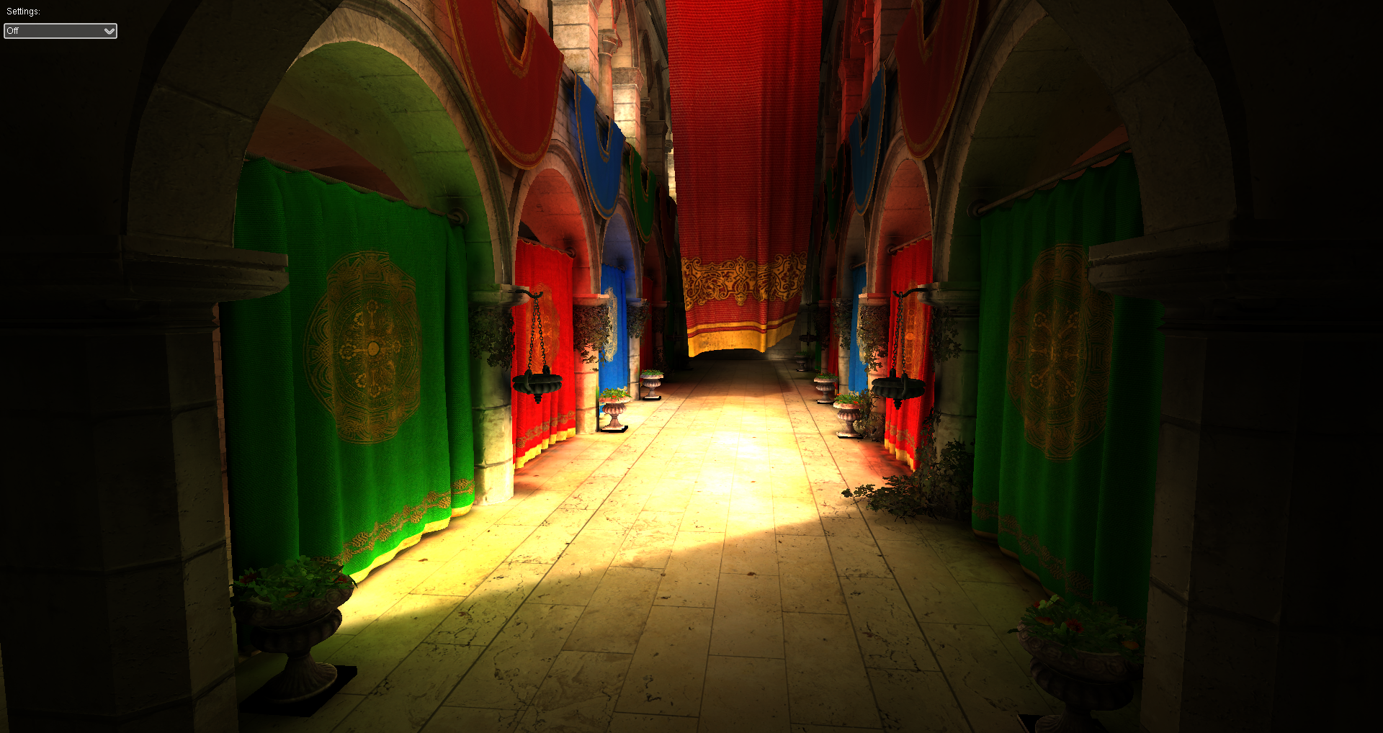
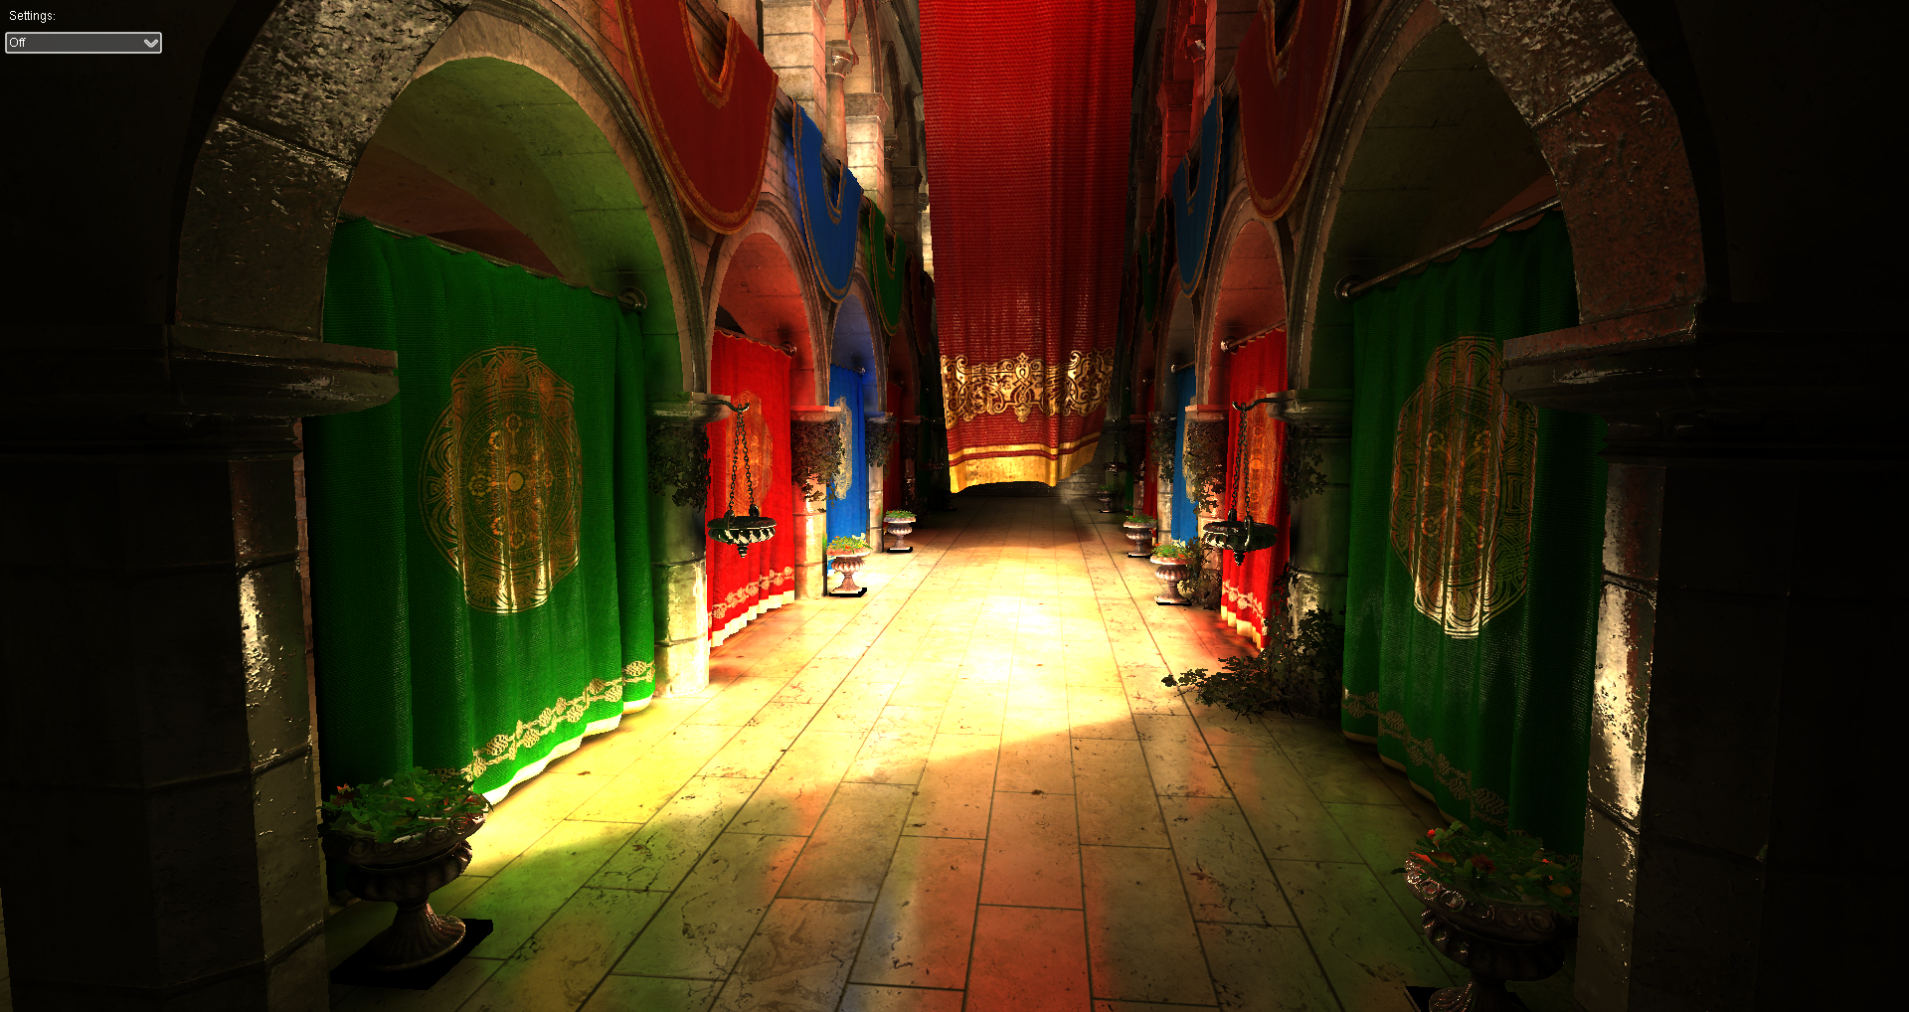

Slide 10
Voxel cone tracing
n
l
Geometry pre-filtering
Traced like a participating media
Volume ray-casting
Voxel representation
Scene geometry : Opacity field
+ Incoming radiance
r
Ray cone footprint
Quadrilinearly interpolated samples
3D MIP-map pyramid
of pre-filtered values
Notes:
So with this new voxel-based cone-tracing model, we can replace a set of rays inside the foortprint of a cone, #by casting only a one unique ray.
To allow this, we pre-filter both the scene geometry and the lighting, and we transform them into a semi-transparent participating media.
This participating media is stored at multiple resolution in our voxel octree, as a sparse 3D MIP-map pyramid.
The ray is marching inside this participating media, using decreasing voxel resolution from the MIP-map pyramid to accurately approximate the cone footprint.
============================
we transform the scene geometry
we use a down-sampled / pre-filtered version of the scene geometry and lighting,
that is stored in our octree structure, as a sparse 3D MIP-map pyramid.
Participating media

Slide 11
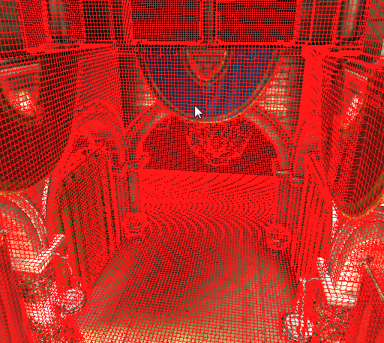
Rendering algorithm
Light source
Light pass (es)
Bake irradiance (RSM)
Filtering pass
Down-sample radiance in the octree
Camera pass
For each visible fragment:
Gather indirect radiance
l
n
Diffuse cones
d
View direction
n

Slide 12
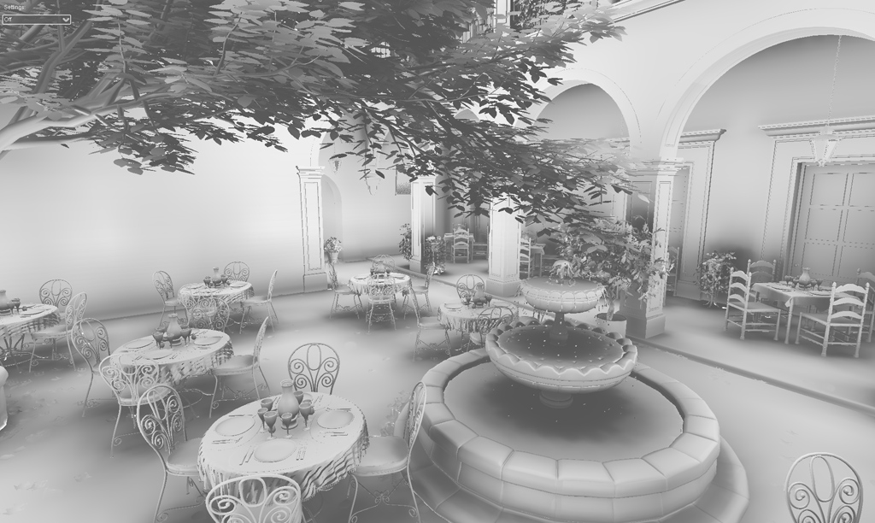
Ambient Occlusion
Scene model courtesy of Guillermo M. Leal Llaguno

Slide 13
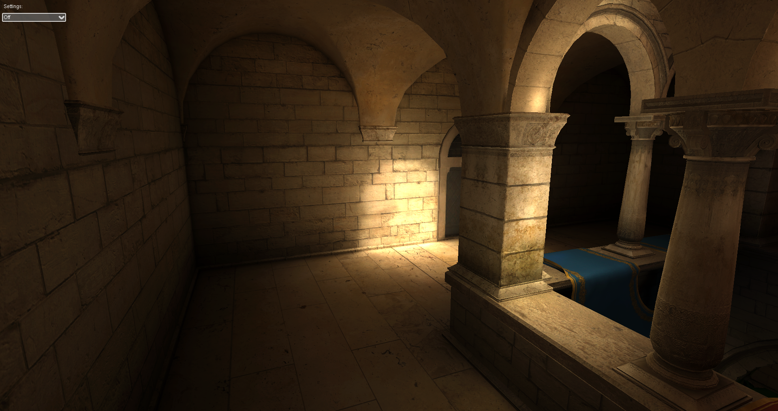
Indirect diffuse

Slide 14
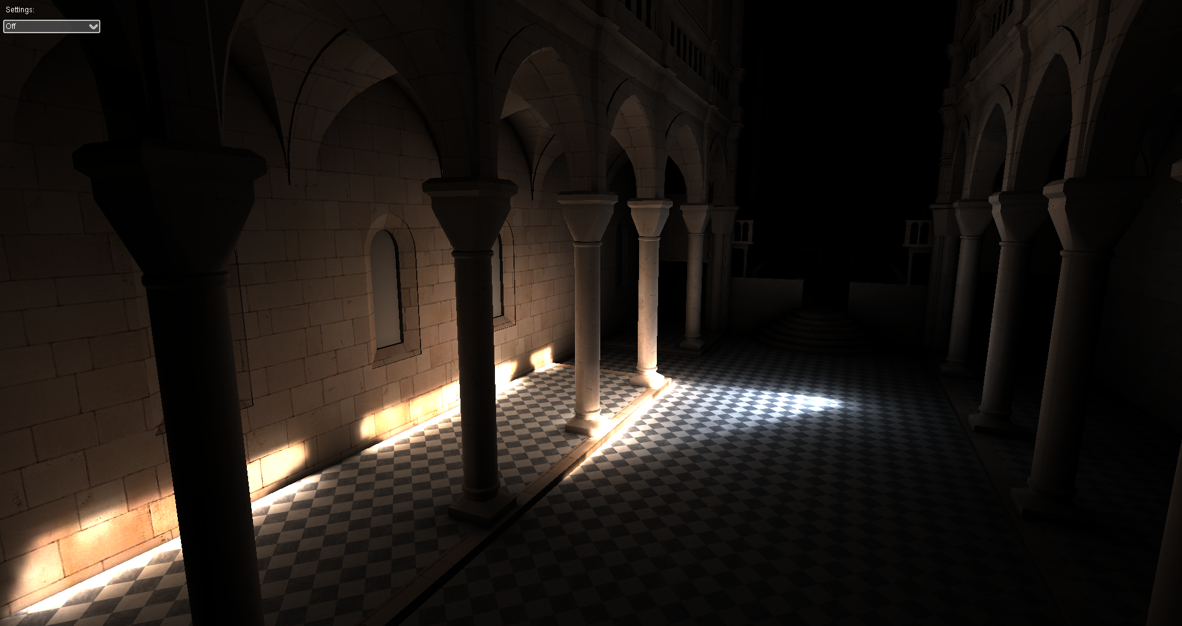
Indirect diffuse

Slide 16
Specular tracing
Light source
l
n
Diffuse cones
d
View direction
n
Specular cone
Voxel-based cone

Slide 17
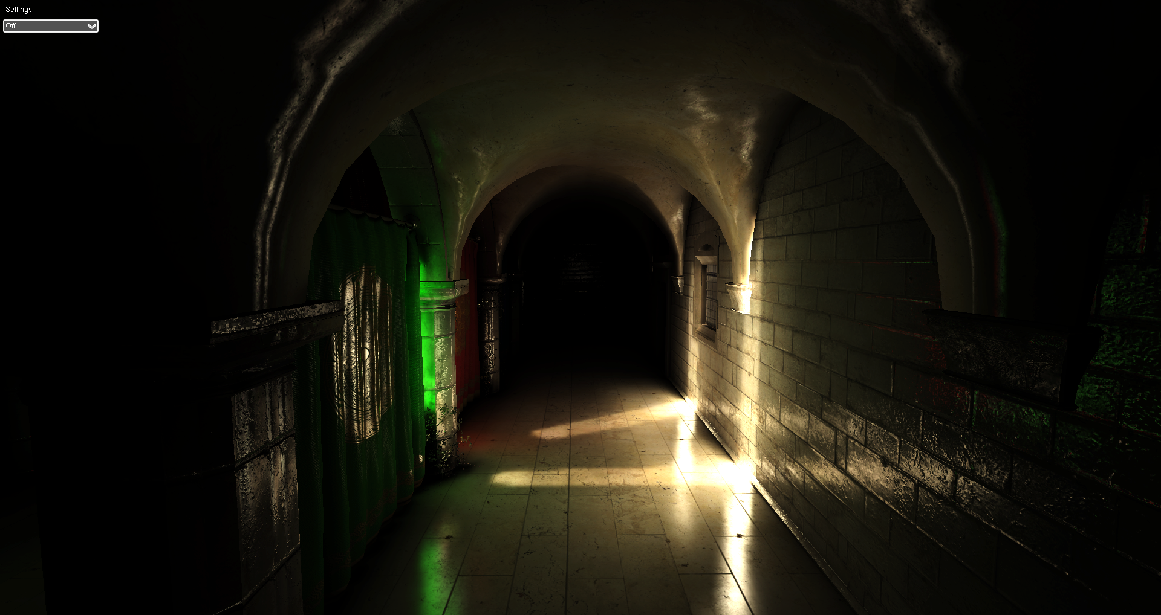
Indirect specular

Slide 18
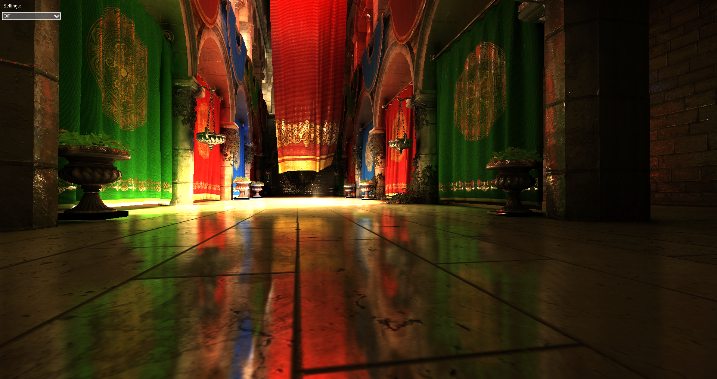
Indirect specular

Slide 21
GPU Voxel Octree
Linked nodes in linear video memory (Octree Pool)
2x2x2 nodes tiles
1 pointer per node to a node-tile
Voxels stored into a 3D texture (Brick Pool)
Allows hardware tri-linear interpolation
1
2
3
1
2
3
4
5
4
5
Linear Memory
3D Texture
6
7
8
9
Brick pool
Octree pool
6
7
8
9

Slide 22
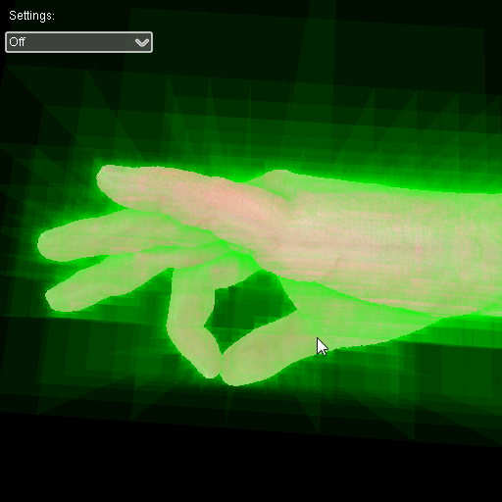
Dynamic Voxelization
Entirely done using the GPU graphics pipeline
Sparse (No plain grid allocation)
Two modes :
Static environment
Pre-voxelized (~20ms)
Dynamic objects
Added to the structure at runtime (~4-5ms)

Slide 23
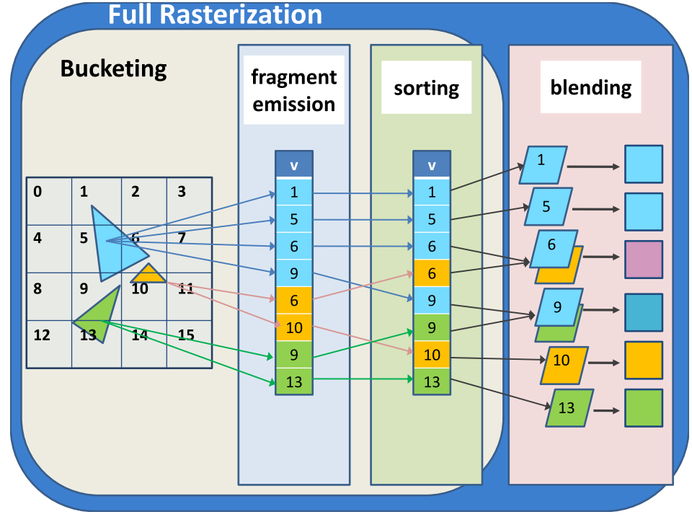
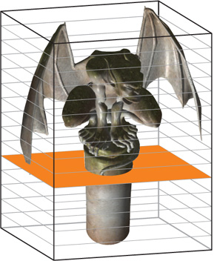
Previous GPU approaches
Compute-based [Schwarz and Seidel 10, Pantaleoni 11]
Not using hw rasterizer
Multi-pass graphics-based
Slice-by-slice [Fang et al. 00, Crane et al. 07, Li et al. 05]
Multiple-slices through MRT [Dong et al. 04, Zhang et al. 07, Eisemann and Decoret 08]
VoxelPipe [Pantaleoni 11]
Crane et al. 2007

Slide 24
OpenGL 4.2 Image Load/Store
Random read/write access to textures
Shaders with side effects !
Shader Model 5 hw (NVIDIA Fermi / Kepler)
Similar to DX11 UAV
Uniform layout(rgba32f) image3D voxData;
imageStore(voxData, ivec3(coords), val);
NVIDIA Bindless Graphics
Pointers to global memory : NV_shader_buffer_load/store
Uniform vec4 *voxData;

Slide 25
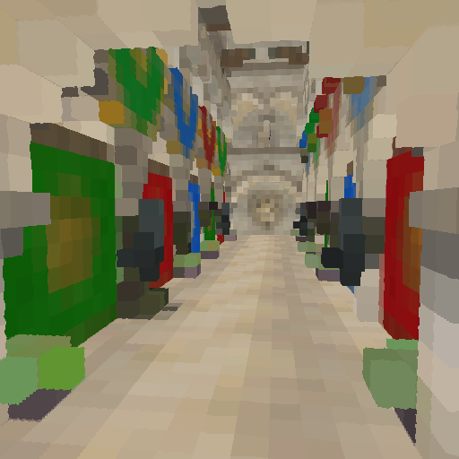
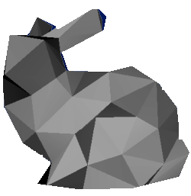
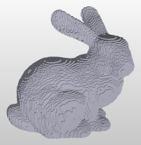
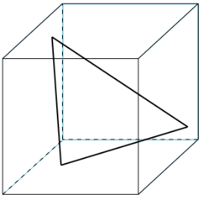
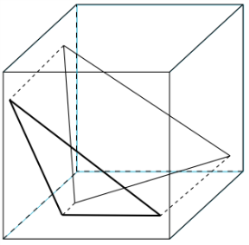
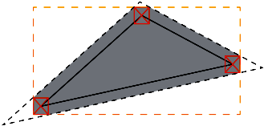
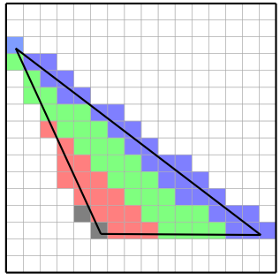
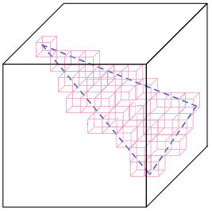
One pass voxelization pipeline
Thin surface voxelization
VS
Geometry Shader
Fragment Shader
Hardware Setup/Raster.
Triangle Dominant Axis Selection
Triangle Projection
Edges Shifting
Fragments Clipping
Voxel Attributes Computation
Write to 3D surface
Conservative Rasterization
x
Y-proj
Normal
z
Z-proj
X-proj
y
y
x
z

Slide 26
Compositing voxel fragments
To texture or linear buffer (global memory)
Native AtomicAdd
INT32
INT64 (NVIDIA Only, global memory)
FP32 (NVIDIA Only, NV_shader_atomic_float extension)
Emulation for any format (RGBA8, RGBA16F…)
AtomicCompSwap / AtomicCompSwap64
(2x-3x speed penalty)
Moving average (RGBA8) + Voxel Anti-Aliasing (coverage mask)

Slide 27
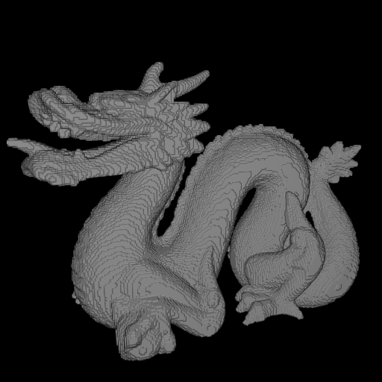
Results
Stanford Dragon
GTX 480 (GF100)
Usually as good as, or even faster than Voxel Pipe [Pantaleoni 11]
Times in ms

Slide 28
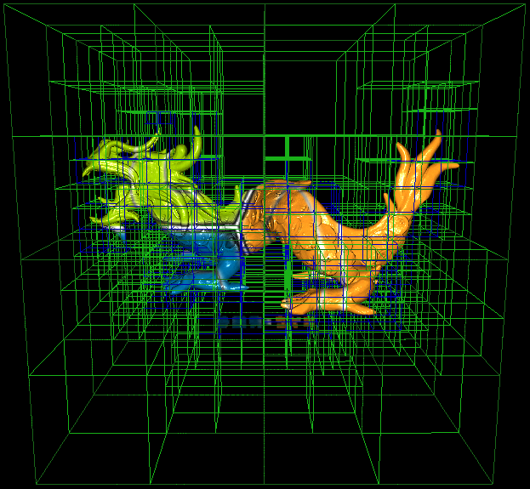
Sparse Octree construction
Sparse voxelization
No plain grid allocation
Two steps:
Octree subdivision 2. Values MIP-mapping
0
2
1
1
2
0

Slide 29
Octree construction (1/2)
0
1
2
Step 1 : Top-down construction
For each level from the root:
Voxelize Mesh at level resolution
Create New Node Tiles
Init New Node Tiles
Tag octree nodes
1 thread per voxel-fragment
1 thread per node
0
1
2
3
4
0
1
2
3
4
5
6
7
8
0
1
2
3
4
5
6
7
8
Node pool
9
10
11
12
13
14
15
16
9
10
11
12
13
14
15
16
Node pool
Node pool
1 thread per node

Slide 30
OpenGL compute kernel emulation
Emulated using a vertex shader
gl_VertexID == ThreadID
No input attribute
Synchronization-free: Indirect draw calls
glDrawArraysIndirect()
Parameters read in video memory
No CPU read-back
Memory barriers: glMemoryBarrier()
Batching all construction steps

Slide 31
Octree construction (2/2)
Step 2: Populating octree with values
Voxelize mesh into leaf nodes
Average all incoming values per voxel
MIP-map values into interior nodes
Write values in leaf nodes
Bottom-up MIP-mapping
2
1
0

Slide 32
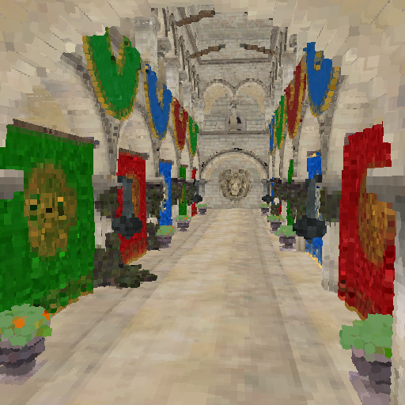
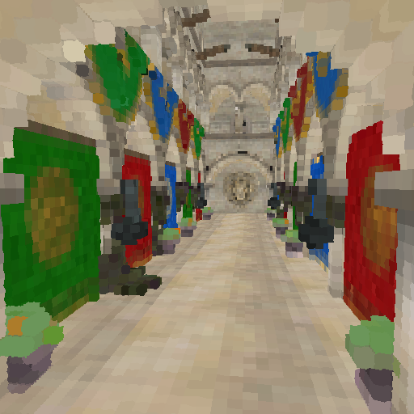
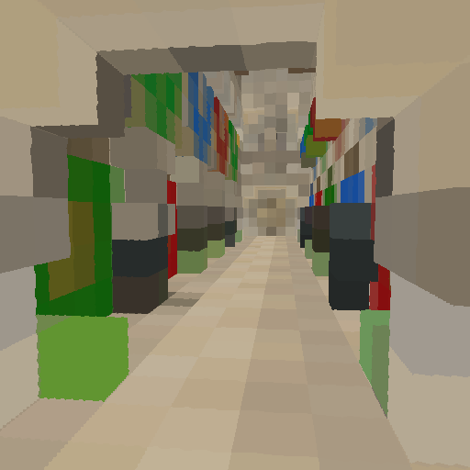
Results
9 levels octree (512^3)
RGBA32F
Kepler GK104 performance
30% - 58% faster than Fermi GF100
Atomic merging up to 80% faster.
Times in ms

Slide 33
OpenGL Insights
Octree-Based Sparse Voxelization Using The GPU Hardware Rasterizer
Cyril Crassin and Simon Green
To be released for Siggraph 2012
Patrick Cozzi & Christophe Riccio

Slide 34
Thank you !

Slide 35
Talk
S0610 - Octree-Based Sparse Voxelization for Real-Time Global Illumination Cyril Crassin (NVIDIA) Discrete voxel representations are generating growing interest in a wide range of applications in computational sciences and particularly in computer graphics. A new real-time usage of dynamic voxelization inside a sparse voxel octree is to compute voxel-based global illumination. When used in real-time contexts, it becomes critical to achieve fast 3D scan conversion (also called voxelization) of traditional triangle-based surface representations. This talk describes an new surface voxelization algorithm that produces a sparse voxel representation of a triangle mesh scene in the form of an octree structure using the GPU hardware rasterizer. In order to scale to very large scenes, our approach avoids relying on an intermediate full regular grid to build the structure and constructs the octree directly. Topic Areas: Computer Graphics Level: Intermediate Day: Tuesday, 05/15 Time: 2:30 pm - 2:55 pm Location: Room B

